Slide 1

Are Cognitive Architectures Useful for Power System Applications?
Jose C. Principe, Ph.D.
Distinguished Professor of ECE
University of Florida
www.cnel.ufl.edu

Slide 2
Acknowledgements
Joint work with my colleagues Andreas Keil and Vladimiro Miranda
Students: Kan Li,
Goktug Cinar
Rakesh Chalasani
Deniz Erdogmus,
Weifeng Liu,
Badong Chen,
Supported by NSF, ONR, DARPA

Slide 3
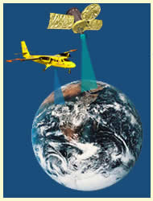
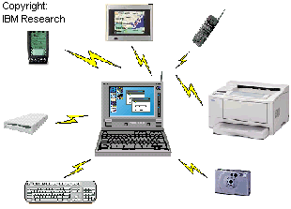
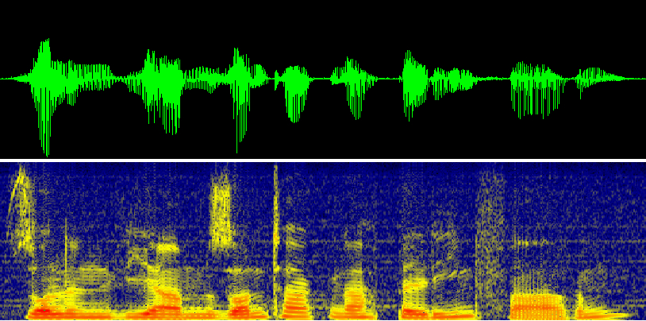

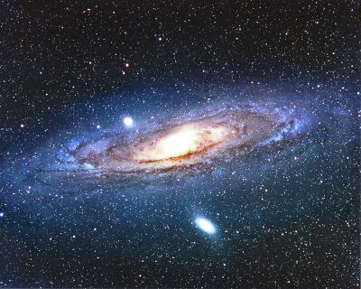
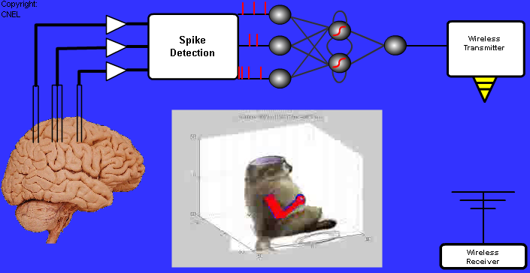
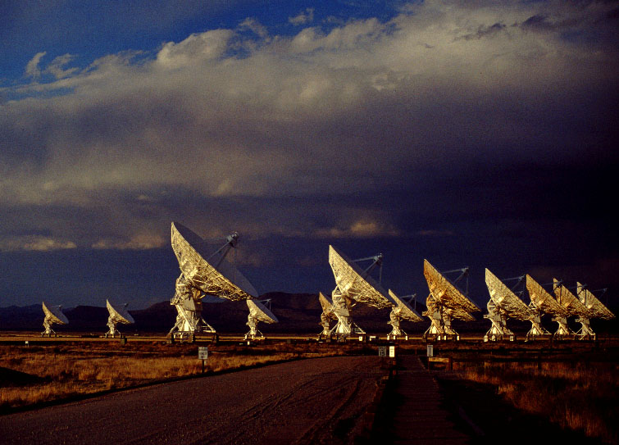
Data Mining: From data to Information
Wireless
Communications
Remote
Sensing
Speech
Processing
Information
Biomedical
Applications
Sensor
Arrays

Slide 4
From Data to Information
There are multiple approaches to deal with data mining, but for physical systems the model learning approach is still the oldest and one of the most efficient
Need to decide THREE things: the mapping function, the cost and the adaptive algorithm.
Recently because of complexity the architectures and representation also became important
Data d
f(x,w)
Data x
Adaptive
System
Output
y
Error d-y=e
Cost Function
Adaptive
Algorithm

Slide 5
Learning Paradigms
Basically, three
  Supervised Learning
  Reinforcement Learning
  Unsupervised Learning
Supervised learning is efficiently, but costly for big data, and the system only learns mappings
Unsupervised learning traditionally only extracts local modes of PDF, but does not need extra labels.
HOWEVER users are still in the middle controlling the data that is given to the learning system!

Slide 6

Mapping Function
Feedforward Topology
We keep using linear feedforward models, the finite impulse response (FIR) filter
FIR filter, combinatorial model, no context/memory: static mapping.
But optimization is linear in the weights
Current
sample
h(1)
Σ
h(L)

Slide 7
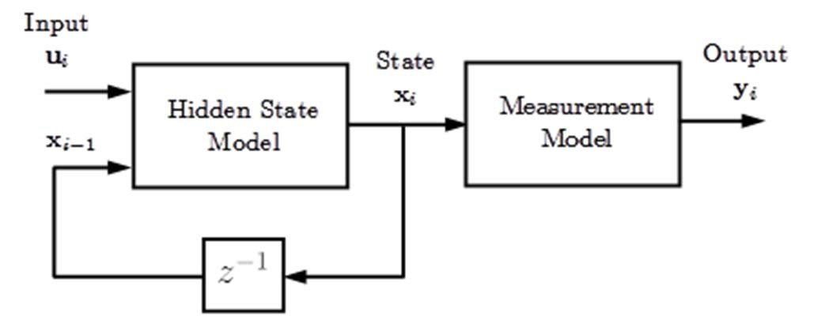















Mapping Function:
General Continuous State-Space Model
LEARNING MACHINE
Current
sample

Slide 8
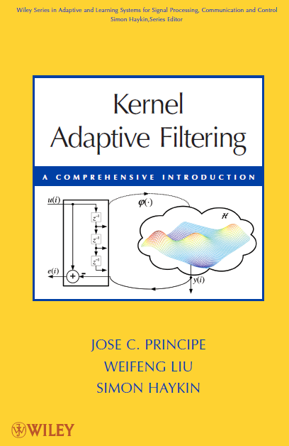
Nonlinear Mapping Functions
Kernel Adaptive Filtering
Map the data nonlinearly to a Hilbert space of functions
Develop a linear model and adapt the parameter’s function using the reproducing properties of kernels.
KAFs are feedforward and are universal and have convex optimization, creating a NEW CLASS of systems we called CULMs (Convex Universal Learning Machines)
Recently we extended the KAF to
include recurrency, with a new topology
called KAARMA (not a CUM)
Principe J., Chen B., “Universal Approximation with Convex Optimization:
Gimmick or Reality”, accepted IEEE Computation Intelligent Magazine,
vol. 10, no. 2, pp. 68-77, 2015

Slide 9

The Cost Function
Information Filters: Given data pairs {x_{i},d_{i}}
  Optimal Adaptive systems
  Information measures
Embed information in the weights of the adaptive system
Data d
f(x,w)
Data x
Adaptive
System
Output
y
Error d-y=e
Cost Function
Information
Adaptive
Algorithm

Slide 10
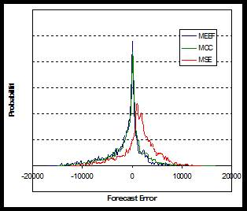
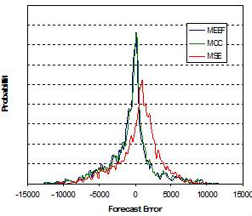
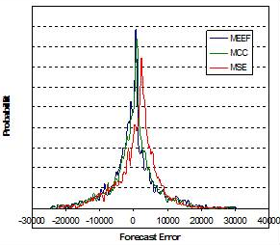
Application to Wind Power:
Comparing error pdf for 3 wind farms
Predictors trained with INFORMATION measures (entropy and correntropy) lead to better results.
A substantially different error for the same mapping function (more errors close to zero w.r.t. MSE)
Why? Because forecasting the wind is a problem with non-Gaussian errors
(Joint work with V. Miranda)
A
B
C
Entropy models: improvement in prediction quality in 72 h ahead predictions

Slide 11
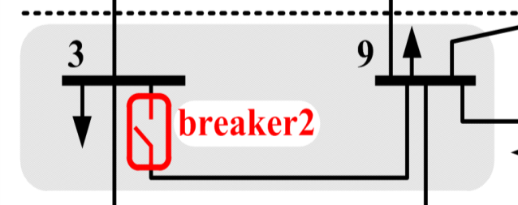
Identifying Breaker Status
Is it possible to guess, based only on local electric data (measurements) the status of a breaker inserted in a network?
CONJECTURE
The topology information is hidden (or is diluted) in the values of the electric variables.
  So, distinct topology states must become somehow reflected in distinct shapes of the manifold supporting the electric data.
How to unveil such information?
  Hint: the breaker status is a macro-feature…

Slide 12
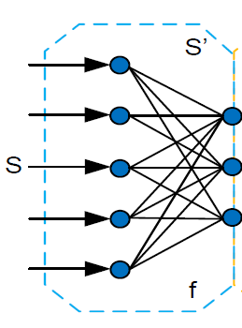
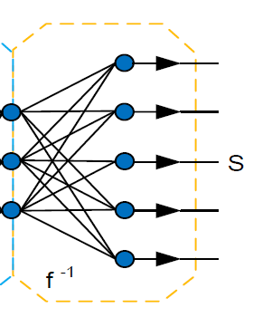
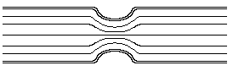
Maximizing Information Flow Through Autoencoders
A perfect autoencoder will preserve maximum information from input to output.
The first half, trained in unsupervised mode, should yield at its output the maximum amount of information as presented at the input when trained with mutual information.
INFORMATION
INFORMATION’
Info loss

Slide 13
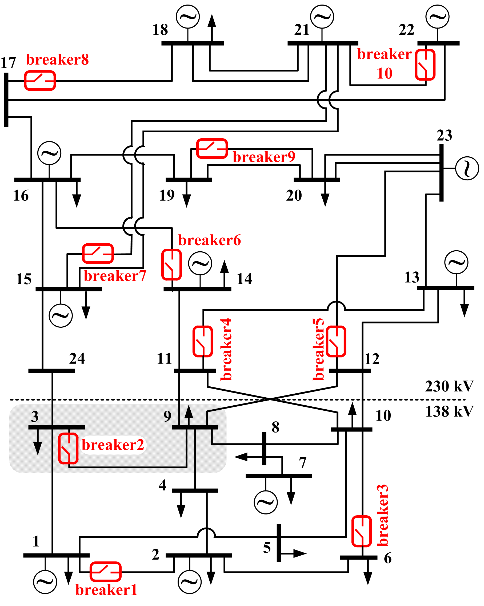
Two-step ITL training
Case: breaker 2
(Only power, no voltage information)
Autoencoder | Model | MSE
Breaker 2 open | Single step | 0.0046
 | 2-step ME | 0.0019
 | 2-step MQMI | 0.0014
Breaker 2 closed | Single step | 0.0053
 | 2-step ME | 0.0015
 | 2-step MQMI | 0.0007
True Positive: br. closed, prediction: closed
False Positive: br. open, prediction: closed
False Negative: br. closed, prediction: open
True Negative: br. open, prediction: open
 | TP | FP | FN | TN
Single step | 4928 | 104 | 5 | 4963
2-step MQMI | 4919 | 0 | 14 | 5067
Remarkable! 14 in 10,000!
Joint work with V. Miranda

Slide 14
Current Frontiers in Signal Processing
We have now tools to deal with non Gaussianity and nonlinearity in mappings. The less known issues are:
Nonstationarity, in particular spatio-temporal problems where there are no labels (Generalized state models are critical here)
Architectures for autonomous learning (representation) to conquer the complexity of spatio-temporal structure.

Slide 15
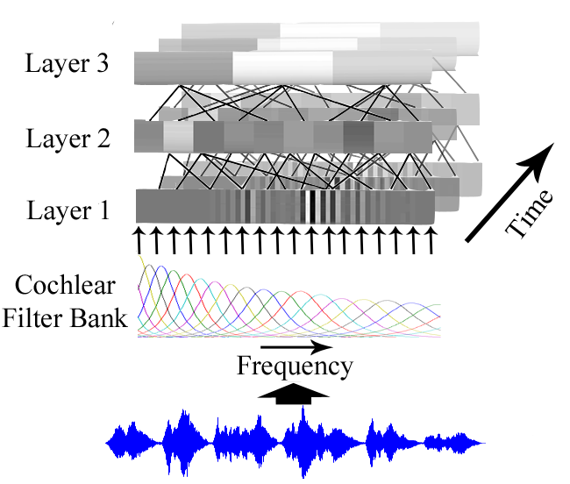
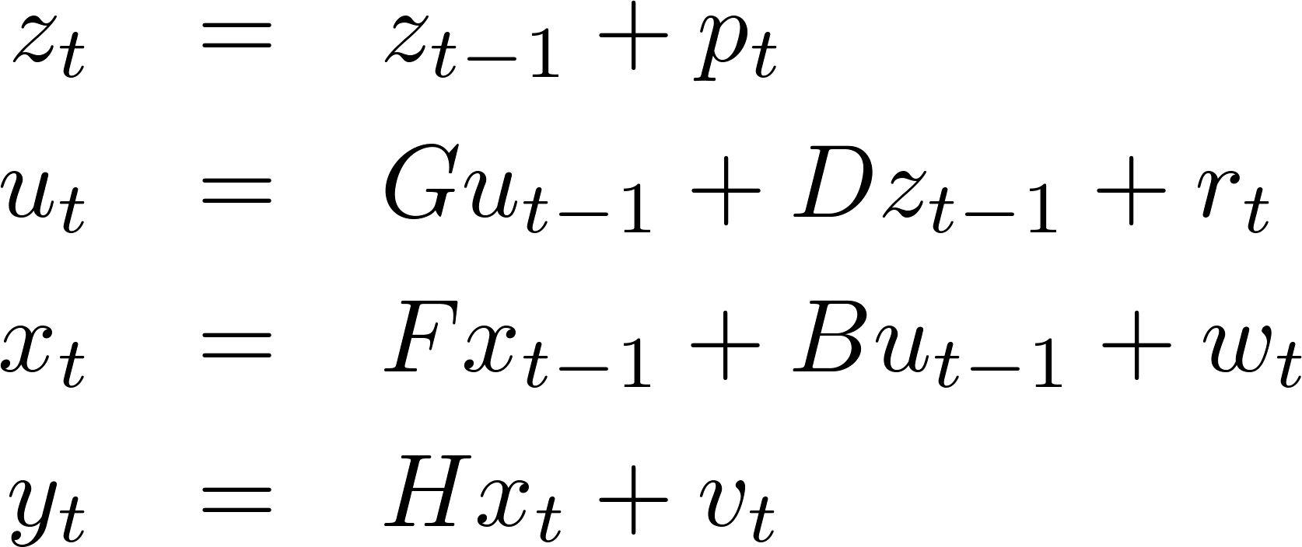
Hierarchical Linear Dynamical System for unsupervised time series segmentation
The linear model consists of one measurement equation and multiple state transition equations.
By design the top layer creates point attractors (Brownian state) to extract redundancies in the sound time structure.
The nested HLDS is driven bottom-up by the observations, and top-down by the states so indirectly it segments the input in spectral uniform regions.
Cinar G., Príncipe J., “Clustering of Time Series Using a Hierarchical
Linear Dynamical System”, in Proc. ICASSP 2014, Florence, Italy

Slide 16
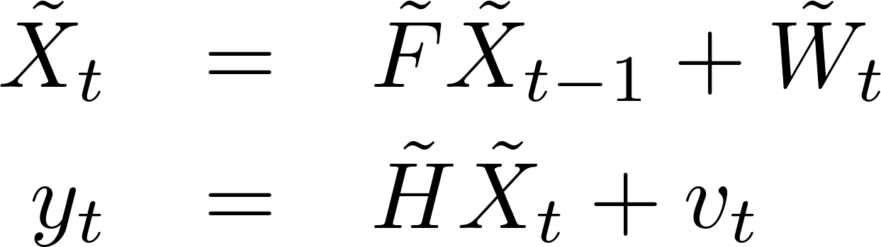
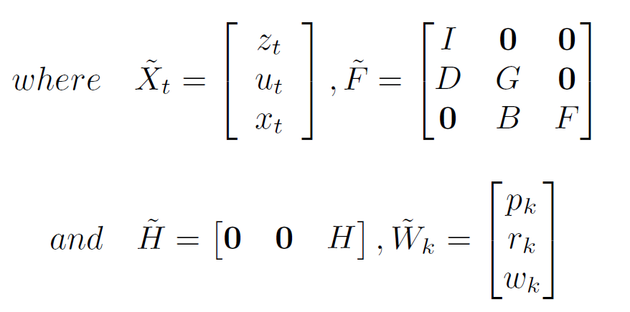
State Estimation in Joint Space
We can re-write the nested dynamics as follows:
These equations define a joint state-space where we can do the estimation of all the hidden states in all the layers simultaneously.
Therefore we can use the unconstrained cost function for inference and exploit the computational efficiency of the Kalman Filter.
Equivalent to a single layer linear model!
Constraints naturally enforced by design

Slide 17
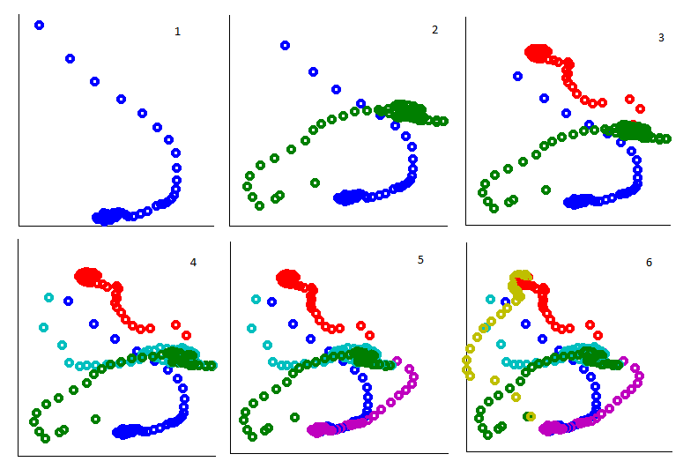
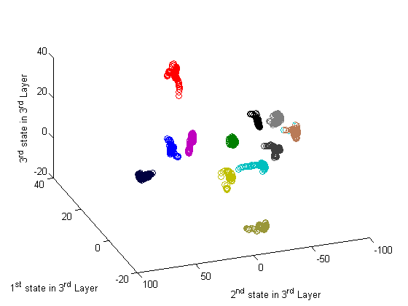
Point attractors for Trumpet Notes
Train with audio samples from Univ. of Iowa Musical Instrument notes (2 sec sustained notes) in the range E3-D6 for the nonvibrato Trumpet.
The algorithm organizes in an unsupervised fashion the different time structure of notes into point attractors in the state space of the highest layer (Hopfield network).

Slide 18
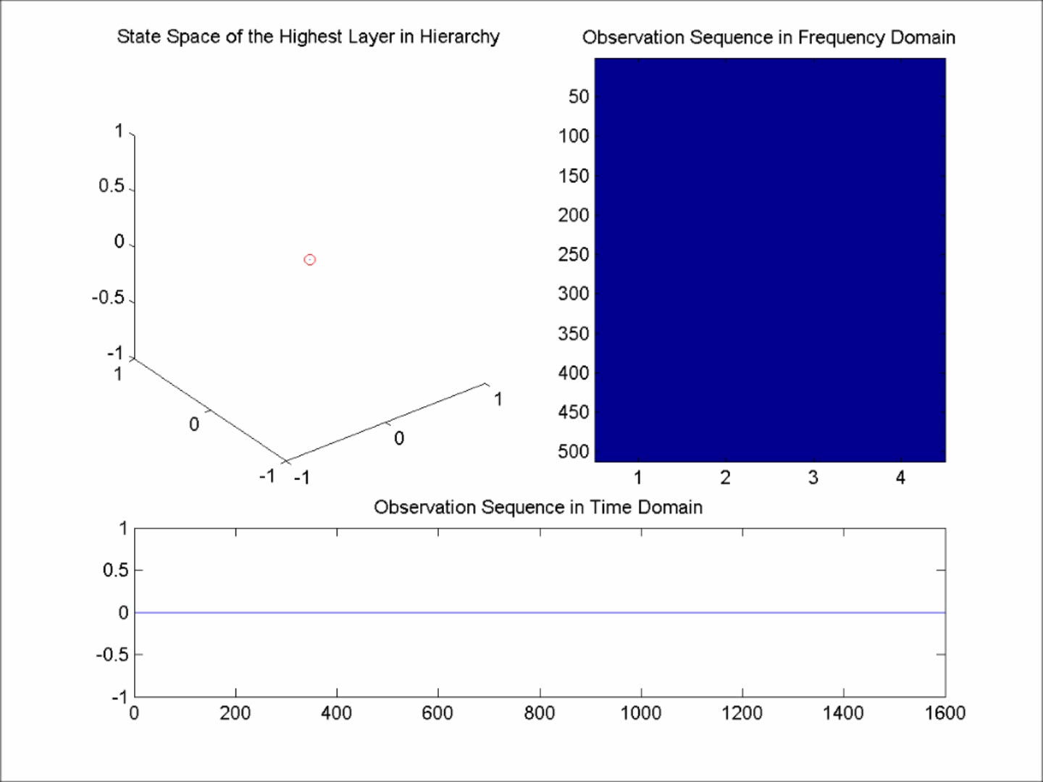
Performance in Music Clips
We play this motif under different conditions.
3 different levels of amplitude magnitudes.
Crescendo
Decrescendo
Different Tempos
Observe that the same trajectory is followed all through these dynamic changes.

Slide 19
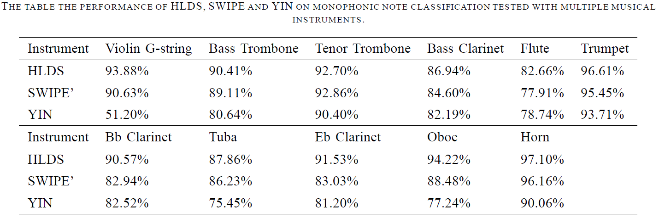
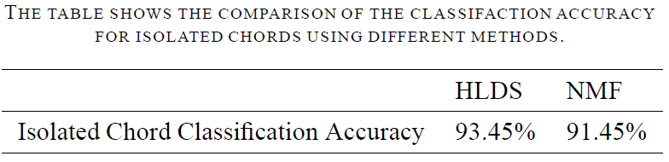
Monophonic/Chord Note Classification

Slide 20
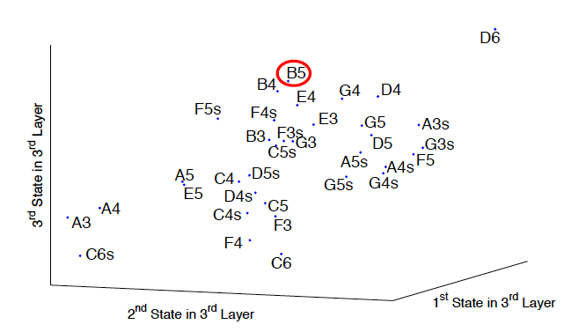
Advantage of Continuous State Space
Discovery of Notes
We train 7 models (s = 3, k = 10) leaving out one note (B5). How would the model classify the missing note?
The model chooses notes that are musically close to B5, i.e. the model assigns either other octaves of B, or notes that are related as perfect fifths to B
The model also generalizes from the trumpet to the saxofone.
We conclude that HLDS learned the metric of the music space.

Slide 21
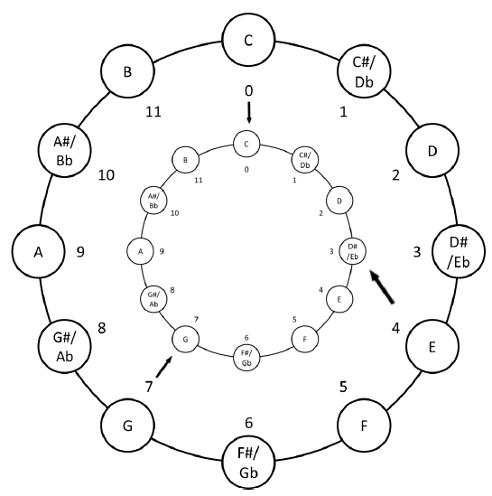
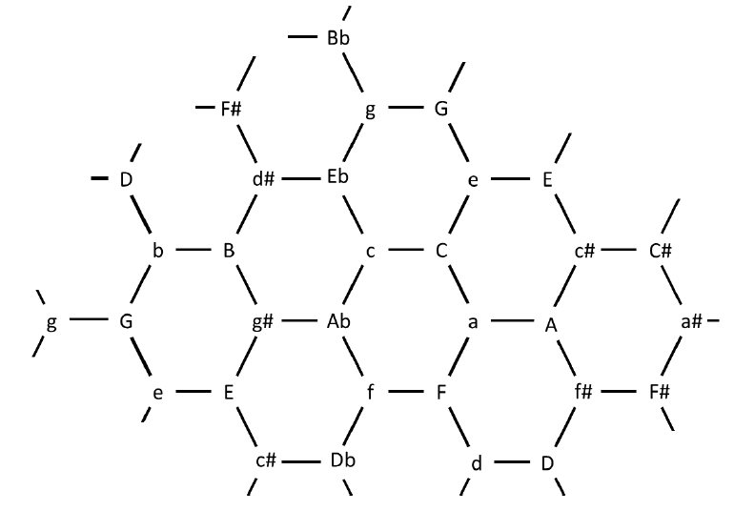
Testing Musical Distances with HLDS
Voice-leading space where pitches are represented by the logarithms of their fundamental frequencies (pitches are close if they are neighbors on the piano keyboard). Hence the distance is measured according to the usual metric on ℜ.
Tonnetz space is based on acoustics (fundamental and harmonics) with notes places in hexagons (tiling of 2 D space).
They do not always agree: Based on the Riemannian Tonnetz, C major is closer to F major, whereas it is closer to F minor based on the voice-leading distance.
Model agrees most often with Tonnetz (10 from 15 models)
Cinar G., Principe, J., A Study of Musical Distance using a Self-organized Hierarchical Linear
Dynamical System, submitted Computer Music Journal, 2015

Slide 22

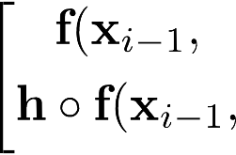












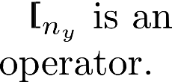









General Continuous Nonlinear State-Space Model
For simplicity we can rewrite the state-space model in terms of a new augmented hidden state vector, via concatenation

Slide 23
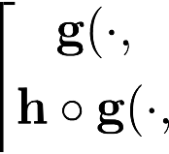














Theory of KAARMA
To learn the general continuous nonlinear transition and observation functions, we map the augmented state vector and input vector into two separate RKHSs
By the Representer Theorem, the new state-space model in the coupled RKHS is defined as the following set of weights (functions in the input space)
Li Kan, Principe J., “Kernel Adaptive Auto-Regressive Moving Average Algorithm”,
accepted IEEE Trans. Neural Networks and Learning Systems, 2015

Slide 24











































Theory of KAARMA
The features in the tensor-product RKHS are
The tensor product kernel is defined by
And the kernel state-space model is expressed as

Slide 25
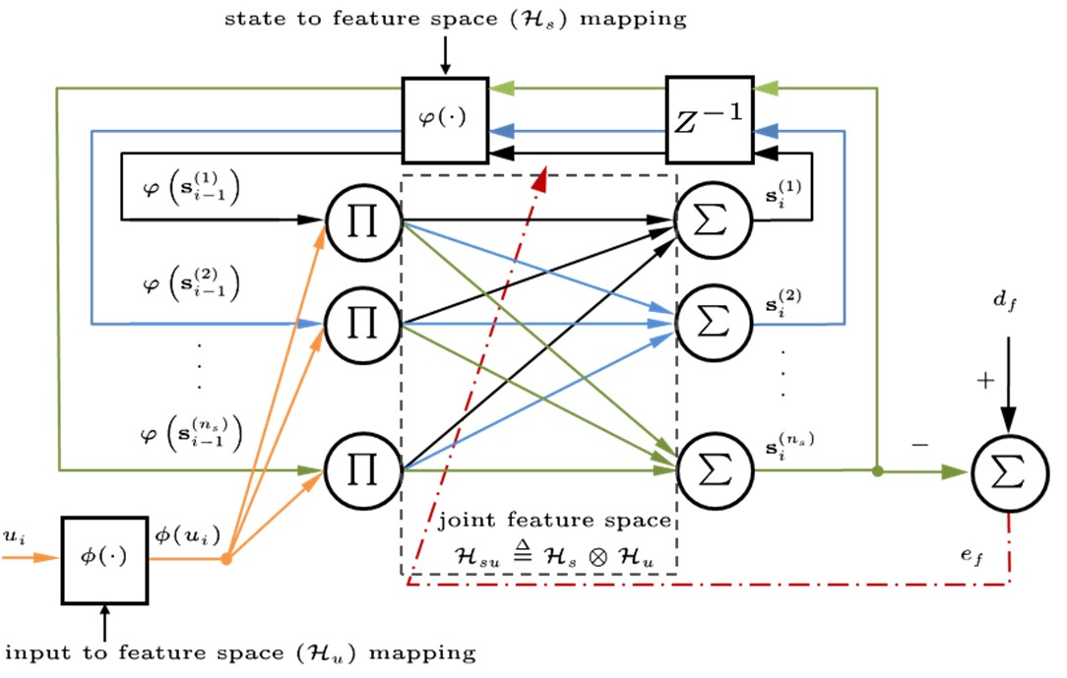










Theory of KAARMA
The general state-space model for dynamical systems is equivalent to performing linear filtering in the RKHS with a recurrent RBF network

Slide 26

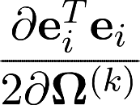
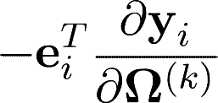
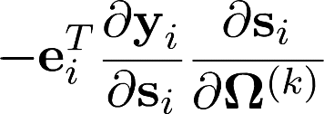




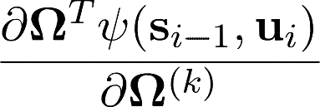
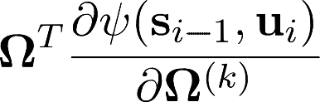













Real Time Recurrent Learning
We evaluate the error gradient at time i with respect to the weight in the RKHS
We expand the state gradient using the product rule

Slide 27










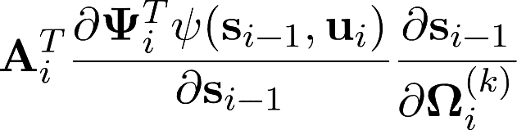
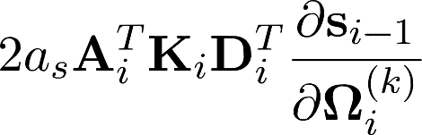

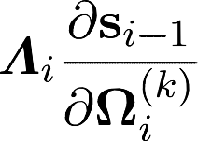
Real Time Recurrent Learning
Using the Representer Theorem, the weight at time i is a linear combination of the prior mappings
Using substitution and applying the chain rule, we obtain

Slide 28

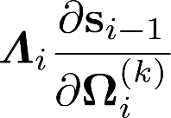















Real Time Recurrent Learning
Finally, we obtain the following recursion
Since the state gradient is independent of the error (future), we can forward propagate it using the initialization

Slide 29
Syntactic Pattern Recognition
Problem: Given a set of positive and negative training sequences, describe the discriminating property of the two.
Positive Samples | Negative Samples
1 | 10
11 | 01
111 | 00
1111 | 011
11111 | 110
111111 | 11111110

Slide 30
The Solution is Surprisingly Simple
Problem:
Positive Samples | Negative Samples
1 | 10
11 | 01
111 | 00
1111 | 011
11111 | 110
111111 | 11111110
(Tomita regular grammar # 1)
Solution:
English: Accept any binary string that does not contain ‘0’.
Regular Expression: 1*
or Deterministic Finite Automaton (DFA):
1

Slide 31
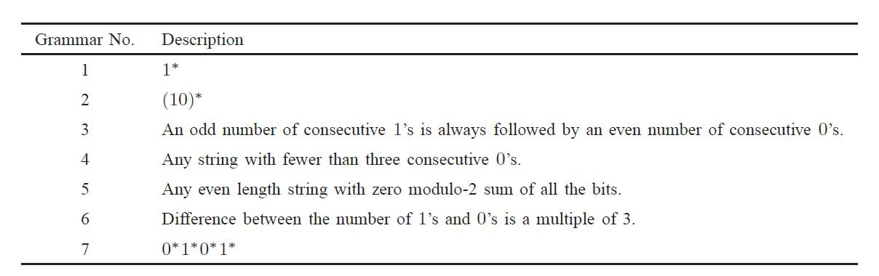
Tomita Grammars
Evaluate the performance of KAARMA using the Tomita grammars as benchmark.

Slide 32
Tomita Grammars
Training set consists of 1000 randomly generated binary strings, with lengths of 1-15 symbols (mean length is 7.758), and labeled according to grammar.
The stimulus-response pairs are presented to the network sequentially: one bit at a time.
At the conclusion of each string, the network weights are updated.

Slide 33
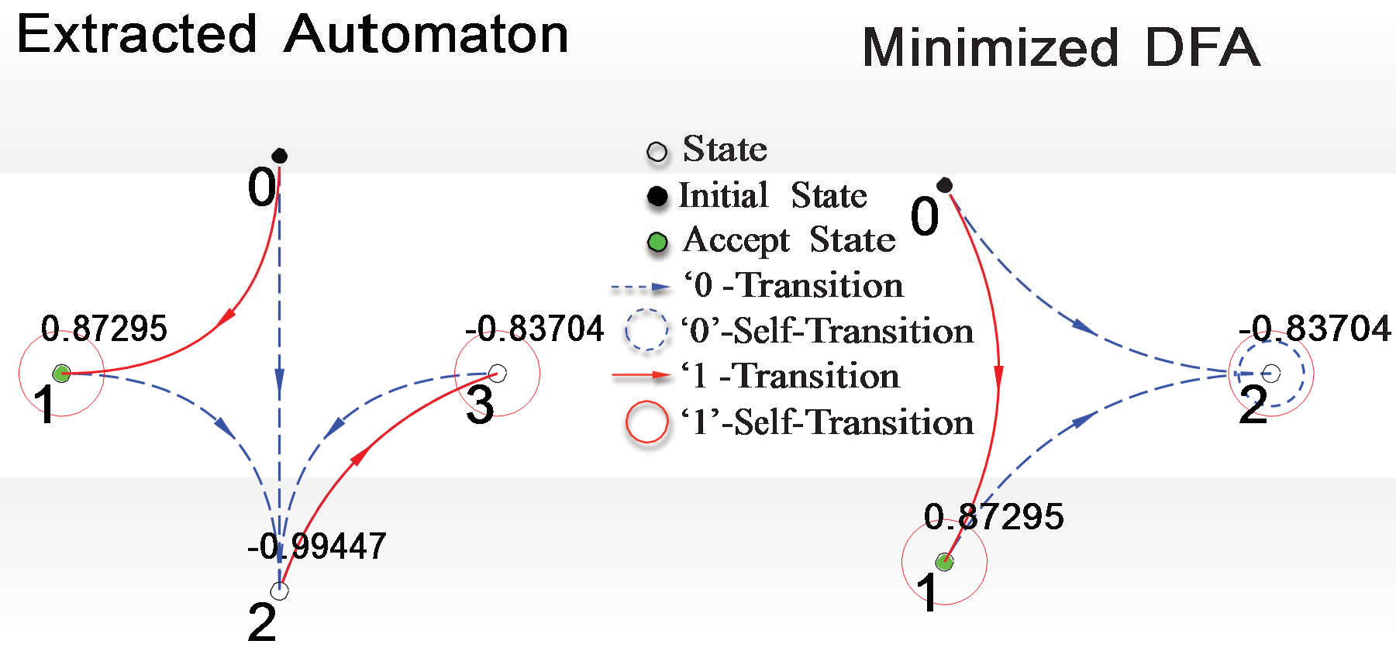
Tomita Grammars
QKAARMA generated DFA for Tomita grammar #1.

Slide 34
Tomita Grammars
Summary of the result
Grammar | QKAARMA size | Extract. DFA | Min. DFA
#1 | 20 | 4 | 3
#2 | 22 | 6 | 4
#3 | 46 | 8 | 6
#4 | 28 | 7 | 5
#5 | 34 | 5 | 5
#6 | 28 | 5 | 4
#7 | 36 | 8 | 6

Slide 35
Comparison to RNN
Performance averaged over 10 random initializations.
RNNs are epoch trained on all binary strings of length 0-9, in alphabetical order.
Test set consists of all strings of length 10-15 (64512 total).
 | Inference Engine | train size | test error | accuracy | network size | Binarized state | DFA size
 | QKAARMA | 170 | 4 | 99.994 | 43.3 | 1.00 | 4.5
Grammar 1 | RNN (Miller & Giles ’93) | 23000 | 1 | 99.999 | 9 (1st) | 1.00 | 9.2
 | RG (Schmidhuber & Hochreiter ’96) | 182 | - | - | 1 (A1) | - | -
 | QKAARMA | 700 | 3 | 99.995 | 29.8 | 1.00 | 6
Grammar 2 | RNN | 77000 | 5 | 99.992 | 9 (2nd) | 1.00 | 9.9
 | RG | 1511 | - | - | 3 (A1) | - | -
 | QKAARMA | 900 | 1343 | 97.919 | 25 | 1.00 | 8.2
Grammar 4 | RNN | 46000 | 1240 | 98.078 | 9 (2nd) | 0.81 | 12.3
 | RG | 13833 | - | - | 2 (A1) | - | -
 | QKAARMA | 1160 | 2944 | 95.437 | 36.6 | 1.00 | 5.5
Grammar 6 | RNN | 49000 | 8725 | 86.475 | 9 (2nd) | 0.67 | 10.5
 | QKAARMA | 4400 | 4623 | 92.834 | 30.2 | 1.00 | 10.8
Grammar 7 | RNN | 121000 | 889 | 98.622 | 9 (2nd) | 0.86 | 10.7
C. B. Miller and C. L. Giles, “Experimental comparison of the effect of order in recurrent neural network” IJPRAI, 1993.

Slide 36
KAARMA Speech Classification Result
TI-46 digit corpus
Training: replicate positive class 3 times, only 1 epoch.
 | Training | Testing
5-State L-to-R KAARMA Chain | 99.33% | 98.62%
5-State Bi-Dir. KAARMA Chain | 99.78% | 99.08%
5-State HMM with mixture of 8 Gaussians | 98.74% | 98%
Li K. Principe J., “Non Linear Dynamical Systems for Speech Recognition, submitted to IEEE Trans.
Signal Processing, Aug 2015

Slide 37
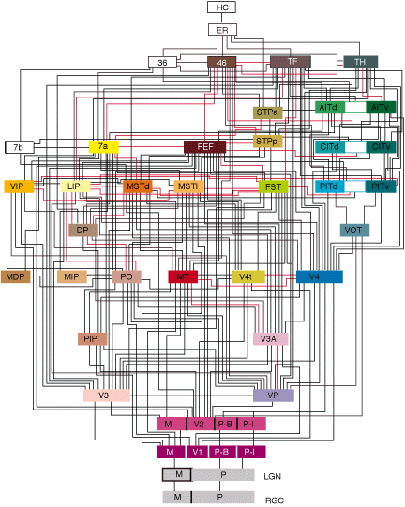
Neural Anatomy of the Visual System
We share Helmholtz’ view that cortical function evolved to explain sensory inputs. As such we seek to understand the role of processing and stored experience in a machine learning framework for the decoding of sensory input.

Slide 38
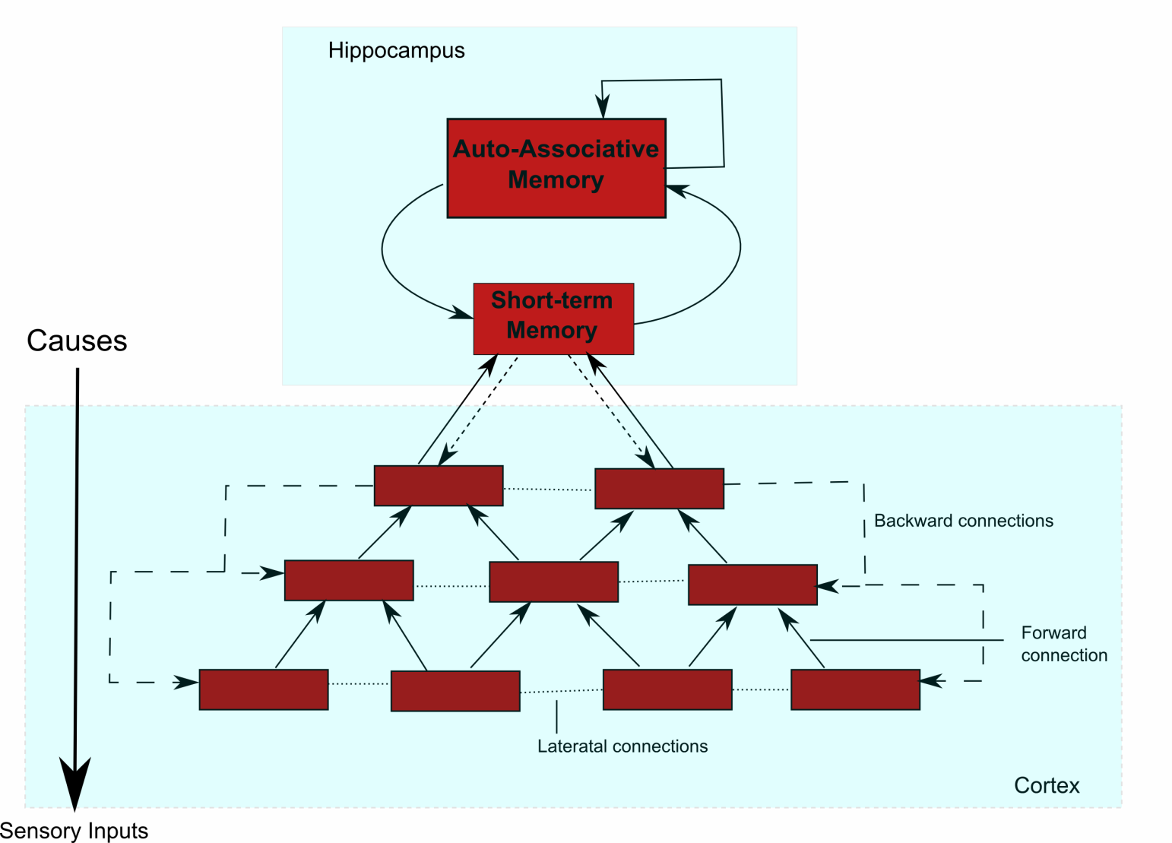
Cognitive Architecture for Object Recognition in Video
Goal:
Develop a bidirectional, dynamical, adaptive, self -organizing, distributed and hierarchical model for sensory cortex processing using approximate Bayesian inference.
Principe J. Chalasani R., “Cognitive Architecture for Sensory Processing”, Proceedings of the IEEE,
vol 102, #4, 514-525, 2014

Slide 39
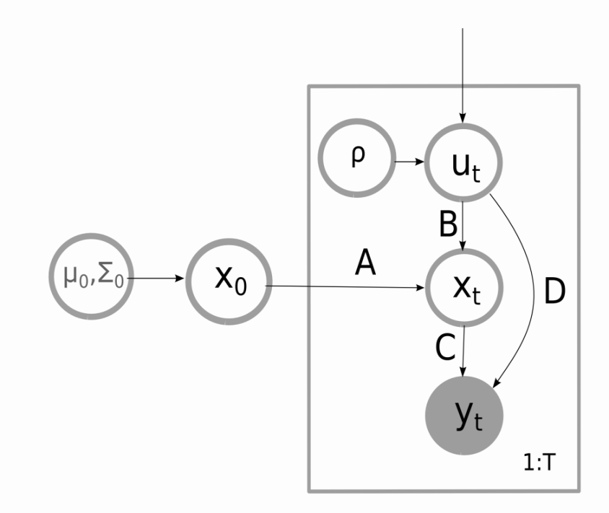
Sensory Processing Functional Principles
  Generalized state space model with additive noise:
    y_{t} – Observations
    x_{t} – Hidden states
    u_{t} – Causal states
  Hidden states model the history and
  the internal state.
  Causes model the “inputs” driving the
  system .
  Empirical Bayesian priors create a hierarchical model, the layer on the top tries to predict the causes for the layer below.

Slide 40
Multi-Layered Architecture
Tree structure with tiling of scene at bottom
Computational model is uniform within layer and across
Different spatial scales due to pooling which also slows the time scale in upper layers
Learning is greedy (one layer at a time)
This creates a Markov chain across layers

Slide 41
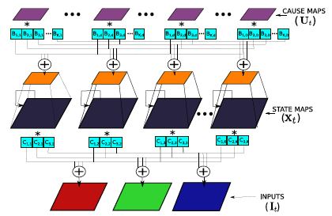
Scalable Architecture with Convolutional Dynamic Models (CDNs)
SINGLE LAYER MODEL
Pooling
unpooling

Slide 42
Convolution Dynamic Models
Each channel I^{m}_{t} is modeled as a linear combination of K matrices convolved with filters C_{m,k}
a_{k,k’} are the lateral connections and here we only consider self-recurrent connections (a_{k,k’}=1 for k=k’, zero otherwise) because the application is object recognition

Slide 43
Convolutional Dynamic Models
Energy function for state maps (x is a matrix):
Energy function for cause maps (x is pooled):

Slide 44
Convolution Dynamic Models
Learning is done layer by layer starting from the bottom
To simplify learning, we do not consider any top down connections for inference
Filters are normalized to unit norm after learning
The gradients are

Slide 45
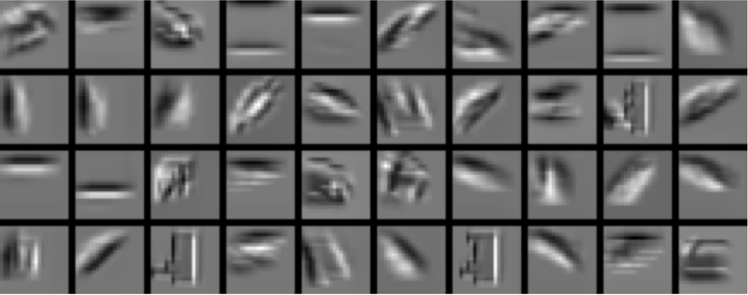
Object Recognition- Training
Learning on Van Hateren natural video database (128x128).
Architecture:
  Layer 1: 16 states of 7x7 filters and 32 causes of 6x6 filters.
  Layer 2: 64 states of 7x7 filters and 128 causes.
  Pooling: 2 x 2 between states and causes.
Layer 1 - Causes
Layer 1 -States

Slide 46
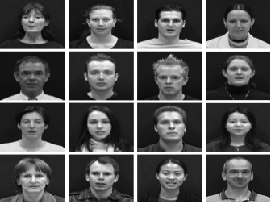
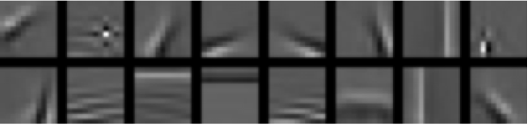
Improving Discriminability in Occlusion
Layer -2 Causes
Example Video frames [VidTIMIT]
Layer -1 Causes
Layer -1 States

Slide 47

Self Taught Learning
With the parameters learned from Van Hateren, use model for generic object recognition, here classify images in Caltech 101.
Extract features from a single bottom up inference (causes from both layer 1 and 2 that are concatenated and presented to a L2-SVM.
30 images for training, and for testing.
Chalasani, R., and Principe, J.C, “Context Dependent Encoding with Convolutional Dynamic
Network", accepted in IEEE Neural Networks and Learning Systems, 2015.

Slide 48

Object Recognition with Time Context
Contextual information during inference can lead to a consistent representation of objects
COIL-100 dataset:
  72 frames per object.
Top-down inference is run over each sequence
  We assume that the test data is partially available (4 frames) during training.
  So called “transductive” learning.
  Four frames per object for training a linear SVM.
  (0º, 90º, 180º, 270º)

Slide 49
Object Recognition Results
Methods | Accuracy (%)
View-tuned network (VTU) [Wersing & Korner, 2003] | 79.10 %
Convolutional Nets with temporal coherence [Mobahi et al, 2009] | 92.25 %
Stacked ISA with temporal coherence [Zou et al, 2012] | 87.00 %
Our method; without temporal coherence | 79.45 %
Our method; with temporal coherence | 94.41 %
Our method; with temporal coherence + Top-down | 98.34 %

Slide 50


Testing Discriminability in Sequence Labeling
Honda/UCSD face data set (20 for training, 39 for testing) using Viola Jones face finding algorithm (on 20x20 patches).Histogram equalization is done. 2 layer model (16,48)₁ (64,100)₂, 5x5 filters, causes concatenated as features

Slide 51
Current Work
So far DPCNs self organize to represent the data. But the user STILL choses the imagery, and by the way, images are still pretty simple (single object in field of view).
How can a system select the type of input that it wishes to analyze and learn, i.e. truly an autonomous learning machine?
We are giving the first steps to design such a system. The DPCN is a fundamental piece of the story.

Slide 52
Are Cognitive Architectures Useful for Power System Monitoring?
A power system is a spatial temporal process with many degrees of freedom.
We design it piece by piece but have no idea if the current operating point is optimal, how resilent it is, when it is going to fail, etc.
We simply overdesign it, keep it in steady state and plan the operation off line.
The complexity of these large man made systems is created by the interactions among the parts, but when we analyze them we use the divide and conquer strategy that exactly throws away the interactions among the parts!

Slide 53
Are Cognitive Architectures Useful for Power System Monitoring?
One can think of the electrical grid with its millions of sensors as some form of a very complex spatial temporal process
If all this sensor information is brought to a central station, one for each pixel, the state of the system will be nothing but a video, where objects are created by local correlation amongst the sensors.

Slide 54
Are Cognitive Architectures Useful for Power System Monitoring?
I submit that a cognitive system, as shown for video, can learn with minimal error a representation space where power system events exist (explain the world as V1)
Then through inference it is possible to put together in a self organizing way higher and higher representations that will become stable, i.e. power system objects will be identified.
Once the objects are identified, then the cognitive system can store and organize objects automatically (content addressable memories). When they reoccur the system will be able to identify them and qualify them from experience if feedback (by the user) is provided.

Slide 55
Are Cognitive Architectures Useful for Power System Monitoring?
If directed, the cognitive system can also recall them and look for similar objects in the input streams, even if the objects are not always the same.
So yes, a cognitive system with human in the loop will be an extraordinary tool for managing the power grid.
In fact with one of my former students I am pursuing a very similar application for power generation plants!

