Slide 1
Training Neural Networks
with Unsupervised Learning
Eder Santana

Slide 2
Supervised vs Unsupervised
Supervised
  Requires input x desired output pairs
  If you have data enough, you are more likely to solve your problems
Unsupervised
  Considers only input data
  Unlabeled data is almost gauranteed

Slide 3
Unsupervised learning
Clustering
Principal Component Analysis
Independent Component Analysis
Dimensionality reduction
Filtering, noise reduction
Metric learning

Slide 4
Unsupervised learning
Autoencoders
Restricted Boltzman Machines
Adversarial Networks
Siamese Networks

Slide 5
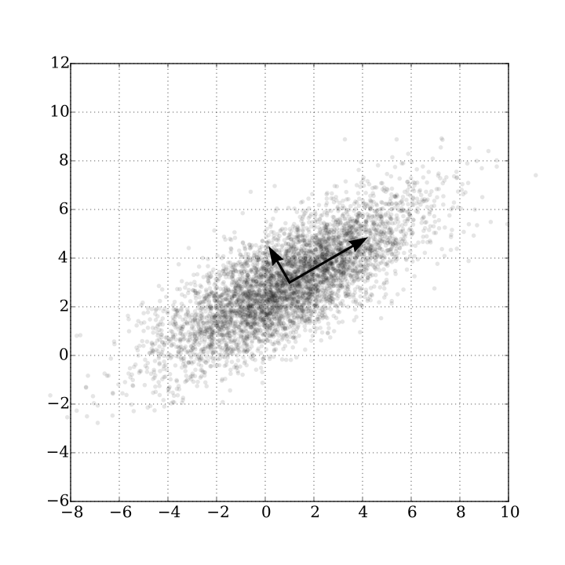
Unsupervised Learning and neural networks
Finding modes in the data

Slide 6

Unsupervised Learning and neural networks
Autoencoder: L = E[ ( x - d(e(x)) )² ]
encoder
decoder

Slide 7
Unsupervised Learning and neural networks
Denoising Autoencoder: L = E[ ( x - d(e(x + n)) )² ]
noise
encoder
decoder

Slide 8
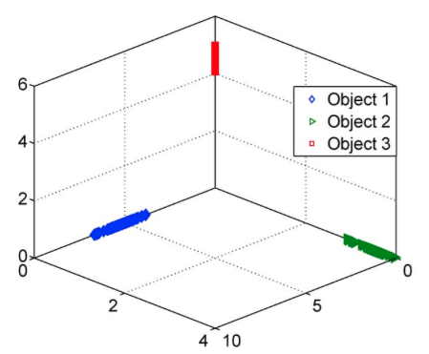
Unsupervised Learning and neural networks
Sparse Autoencoder: L = E[ ( x - d(e(x)) )² ] + 𝜆|e(x)|₁
encoder
decoder

Slide 9
Unsupervised Learning and neural networks
Functional regularization for Autoencoder: L = E[ ( x - d(e(x)) )² ] + 𝜆 D(e, p₀)
encoder
decoder

Slide 10
Unsupervised Learning and neural networks
Sparse Autoencoder: L = E[ ( x - d(e(x)) )² ] + 𝜆|e(x)|₁
Encoder and Decoder as MLPs:
e(x) = tanh(Wx + b)
d(x) = W`e(x) + b

Slide 11
Unsupervised Learning and neural networks
How to go deeper?

Slide 12
Unsupervised Learning and neural networks
How to go deeper?

Slide 13
More videos
Hugo Larochelle: Neural networks [7.6] : Deep learning - deep autoencoder Hugo Larochelle
Neural networks [7.3] : Deep learning - unsupervised pre-training Hugo Larochelle
Nando de Freitas: Machine learning - Deep learning II, the Google autoencoders and dropout

