Slide 1
Deep Learning - Introduction
Eder Santana
Neural Networks for Signal Processing
EEL 6504 - Spring 2016

Slide 2
Introduction
This introduction is divided in two parts
On the need of deep architectures
Problems training deep architectures
Recent advances
Thus, we will cover the pros and cons of deep learning. Each topic contains links to reference papers in the speaker notes.

Slide 3
On the need of deep architectures
The success of machine learning applications (regression, classification, etc) is tied to the quality of the data representation.
Remember the Iris dataset, some of the dimensions were easier to classify then others.
For complex problems where no single dimension of the raw data is discriminative enough, domain knowledge for feature representation is fundamental.
For example, frequency domain representations for speech recognition.
Notes:
Representation learning: reviews and perspectives http://arxiv.org/pdf/1206.5538v3.pdf

Slide 4
On the need of deep architecrtues
But how much can we do with generic priors? Can we design a single algorithm that can be successfully applied to different data domains with minor modifications?
Deep Learning is tightly coupled with the need to learn better representations of data.
Notes:
Representation learning: reviews and perspectives http://arxiv.org/pdf/1206.5538v3.pdf

Slide 5
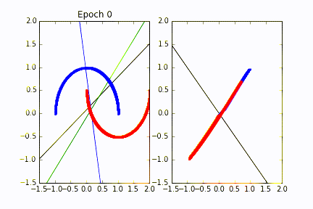
On the need of deep architectures
To illustrate the problem of learning representations. Let us remember what each layer in a MLP does. Each line represents a processing element. The top most layer is a classifier.
Figure: MLP with 3 layers. Showing input to first hidden and output layers

Slide 6
On the need of deep architectures
Each layer learns a feature representation of the layer below. The final goal of those representations is to optimize the criterion being backpropagated.
Assume the problem of classification: The practical observation is that the number of neurons (connections, weights) required by a a single hidden layer MLP is larger than the number required by deep MLP.
“Using tools from measure theory and matrix algebra, we prove that besides a negligible set, all functions that can be implemented by a deep network of polynomial size, require exponential size in order to be realized (or even approximated) by a shallow network.” - Cohen et. al.
Notes:
On the expressive power of deep learning: http://arxiv.org/pdf/1509.05009v2.pdf

Slide 7
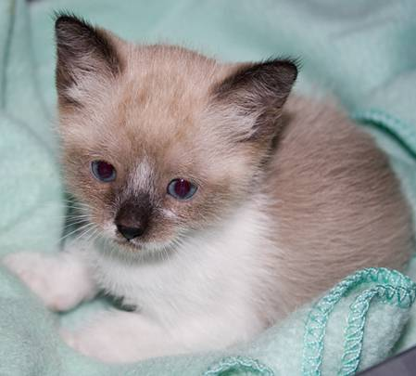
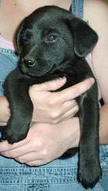
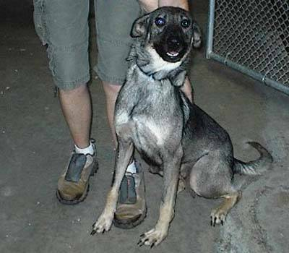
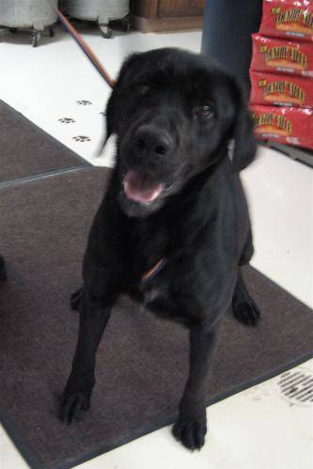
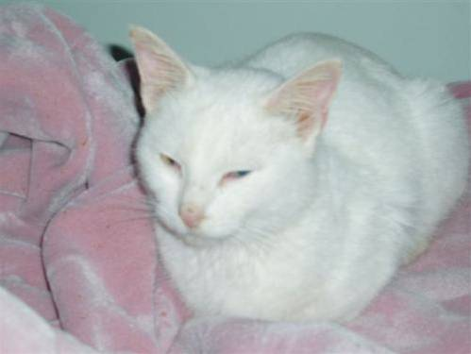
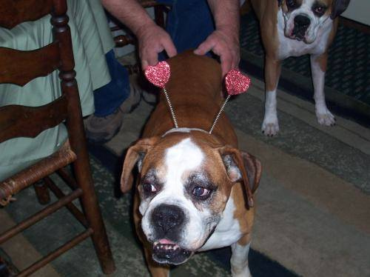
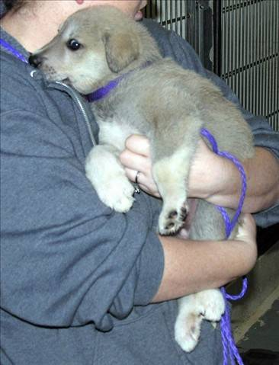
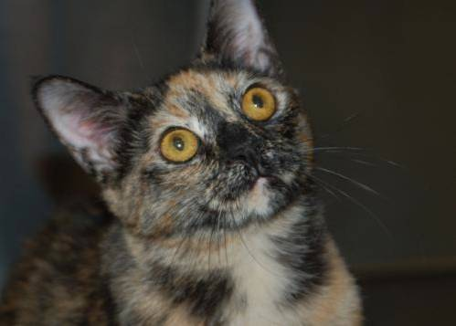
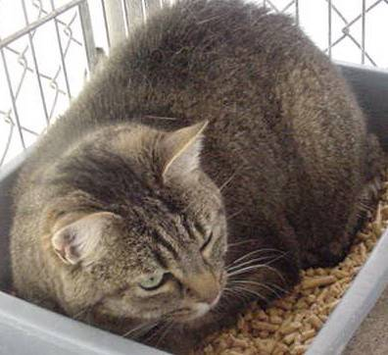
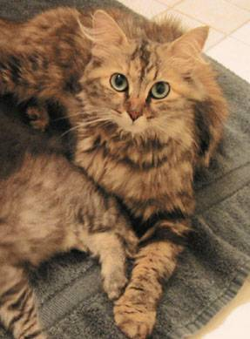
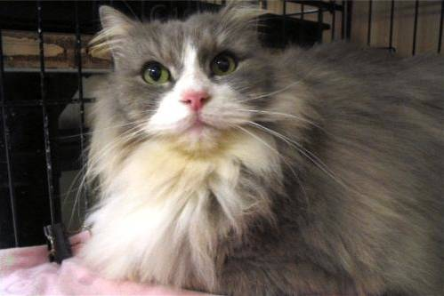
On the need of deep architectures
Learning image multi-scale invariances
In image classification, we want to recognize objects in different view angles and scales.
Images from the Microsoft ASIRRA dataset. Dogs vs Cats dataset on Kaggle: https://www.kaggle.com/c/dogs-vs-cats
Notes:
Using goal-driven deep learning models to understand sensory cortex http://www.nature.com/neuro/journal/v19/n3/pdf/nn.4244.pdf

Slide 8
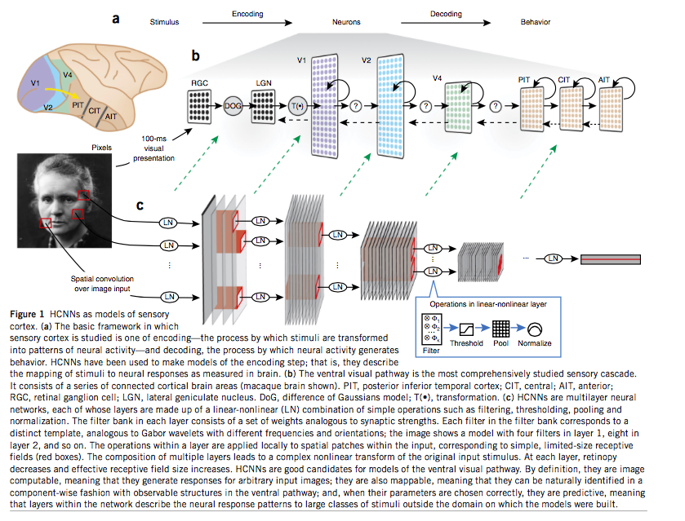
On the need of deep architectures
Learning image multi-scale invariances
How does the human brain image processing pipeline looks like?
Yamins and DiCarlo, 2016
Notes:
Using goal-driven deep learning models to understand sensory cortex http://www.nature.com/neuro/journal/v19/n3/pdf/nn.4244.pdf
This paper investigates the similarity in the representations of the brain and supervised convnets.

Slide 9
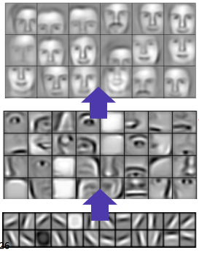
On the need of deep architectures
Learning image multi-scale invariances
What do we learn on each layer?
Example an unsupervised convolutional autoencoer applied to faces
Lee et. al. ICML 2009
Notes:
Convolutional Deep Belief Networks for Scalable Unsupervised Learning of Hierarchical Representations: http://www.cs.toronto.edu/~rgrosse/icml09-cdbn.pdf

Slide 10
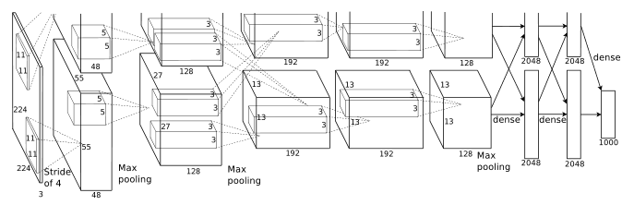
On the need of deep architectures
Learning image multi-scale invariances
What do we learn on each layer of AlexNet (Zeiler variation)?
Krizhevsky et. al. 2012
Notes:
ImageNet Classification with Deep Convolutional Neural Networks: http://papers.nips.cc/paper/4824-imagenet-classification-with-deep-convolutional-neural-networks.pdf

Slide 11
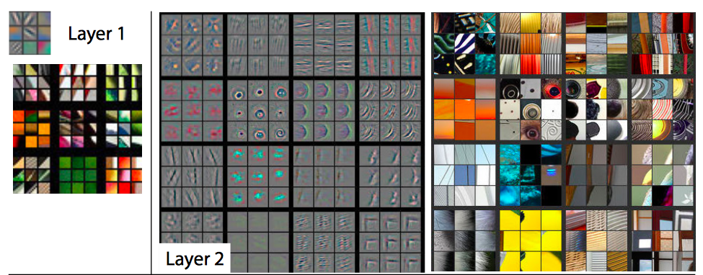
On the need of deep architectures
Learning image multi-scale invariances
What do we learn on each layer of AlexNet (Zeiler variation)? Showing prefrered stimulus and images that drive highest activation.
Zeiler and Fergus, 2013
Notes:
Visualizing and understanding convolutional neural networks: https://www.cs.nyu.edu/~fergus/papers/zeilerECCV2014.pdf

Slide 12
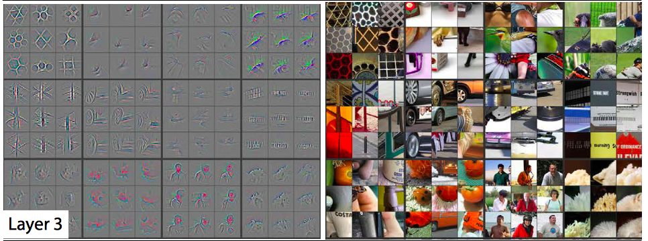
On the need of deep architectures
Learning image multi-scale invariances
What do we learn on each layer of AlexNet (Zeiler variation)? Showing prefrered stimulus and images that drive highest activation.
Zeiler and Fergus, 2013
Notes:
Visualizing and understanding convolutional neural networks: https://www.cs.nyu.edu/~fergus/papers/zeilerECCV2014.pdf

Slide 13
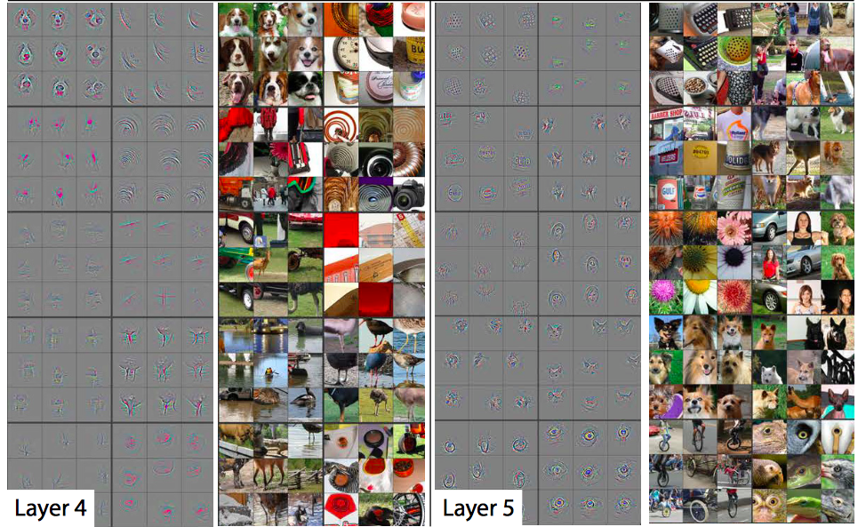
On the need of deep architectures
Learning image multi-scale invariances
What do we learn on each layer of AlexNet (Zeiler variation)? Showing prefrered stimulus and images that drive highest activation.
Zeiler and Fergus, 2013
Notes:
Visualizing and understanding convolutional neural networks: https://www.cs.nyu.edu/~fergus/papers/zeilerECCV2014.pdf

Slide 14
On the need of deep architectures
Learning image multi-scale invariances
Visualizing t-SNE embedding: http://cs.stanford.edu/people/karpathy/cnnembed/
Notes:
Karpathy convnet features t-SNE: http://cs.stanford.edu/people/karpathy/cnnembed/

Slide 15
On the need of deep architectures
Learning invariances in music and speech data
How do you do that using what we already know?

Slide 16
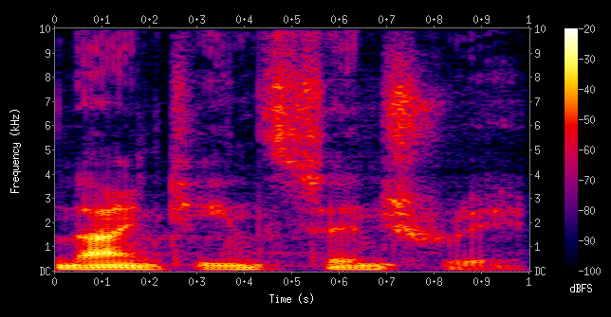
On the need of deep architectures
Learning invariances in music and speech data
“Spectogram is an image and we know convnets”. But what about the time component?

Slide 17
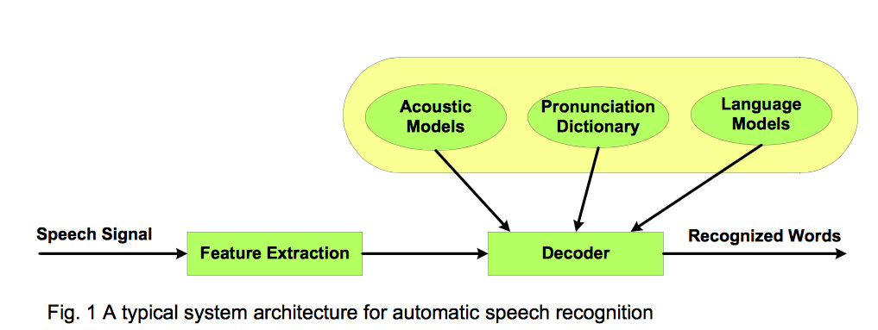
On the need of deep architectures
Learning invariances in music and speech data
Speech recognition (before):
  Get speech “windows”: phonemes
  Represent phonemes using a Gaussian Process or Deep Belief Network (Deep Autoencoder)
  Conect the windows: model phoneme transition using Hidden Markov Model
Yan Zhang
Notes:
http://cs229.stanford.edu/proj2013/zhang_Speech%20Recognition%20Using%20Deep%20Learning%20Algorithms.pdf

Slide 18
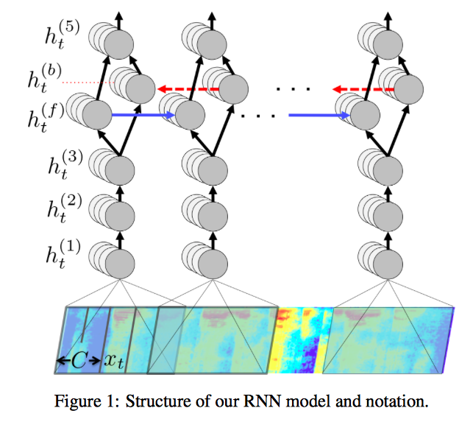
On the need of deep architectures
Learning invariances in music and speech data
Speech recognition (after, end-to-end deep learning):
  No windowing
  First layers are convolutional
  Middle layers are bidirectional recurrent neural networks to represent time context (future classes).
  Cost function is Connectionist Temporal Classification (CTC). It allows sequence inputs to be classifed as a sequence of labels without alignment of training set! i.e the network learns both alignment (where) and recognition (what).
Hannun et. al. 2014
Notes:
Deep Speech: Scaling up end-to-end speech recognition: http://arxiv.org/pdf/1412.5567v2.pdf
Connectionist Temporal Classification: http://www.cs.toronto.edu/~graves/icml_2006.pdf
If you want to understand the theory of HMMs and how to train them I recommend Chapter 5 of Bruce Hayjk lecture notes: http://www.ifp.illinois.edu/~hajek/Papers/randomprocDec11.pdf

Slide 19
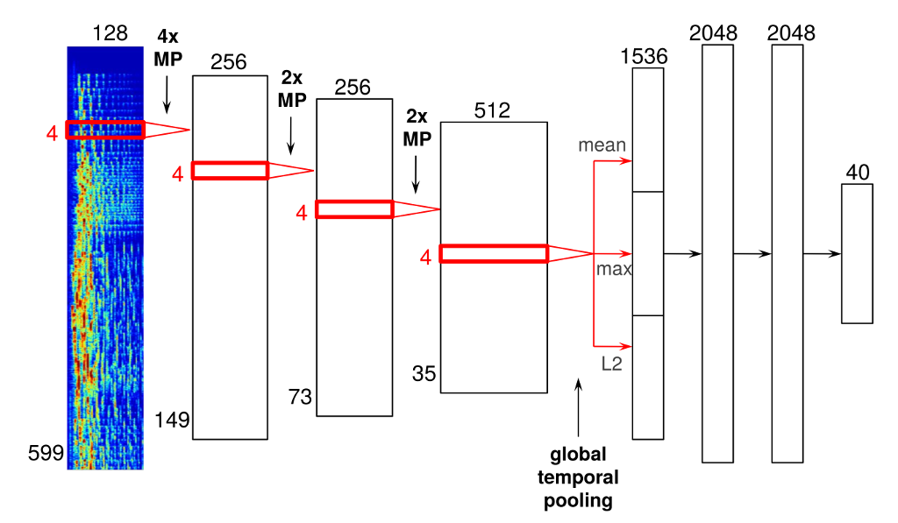
On the need of deep architectures
Learning invariances in music and speech data
Content based music recommendation
Sander Dieleman, 2014 http://benanne.github.io/2014/08/05/spotify-cnns.html
Notes:
Recommending music on Spotify with Deep Learning: http://benanne.github.io/2014/08/05/spotify-cnns.html

Slide 20
On the need of deep architectures
Learning representations for text
How should a computer represent a character or a word?
Signal processing is about Algebra, but how can we represent something like “bread” + “butter” or “king” - “crown”?
We need to represent “words” as vectors! Vector Algebra is well defined.
Notes:
Recommending music on Spotify with Deep Learning: http://benanne.github.io/2014/08/05/spotify-cnns.html

Slide 21
On the need of deep architectures
Learning representations for text
Process
  Represent each word by an unique id (one-hot-encoding, sparse): x
  Initialize word-to-vector embedding (dense): B
  Get word representation in the new space: y = Bx
    Each y is just a row of B
  Adapt B
    How?
Notes:
Recommending music on Spotify with Deep Learning: http://benanne.github.io/2014/08/05/spotify-cnns.html

Slide 22
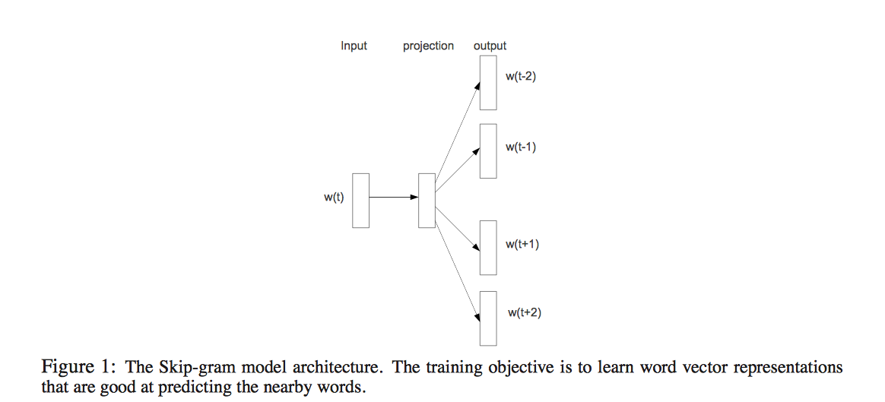
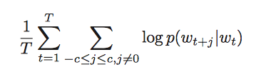
On the need of deep architectures
Learning representations for text
Mikolov et. al. 2013
Notes:
Distributed Representations of Words and Phrases and their Compositionality: https://papers.nips.cc/paper/5021-distributed-representations-of-words-and-phrases-and-their-compositionality.pdf

Slide 23
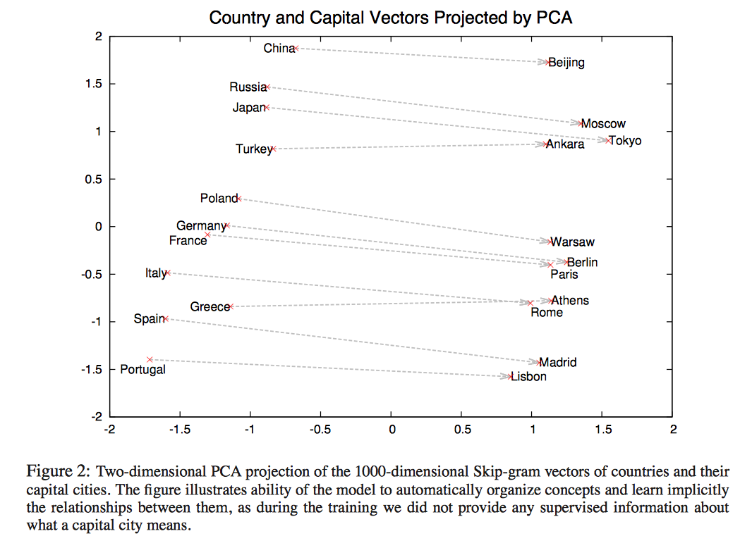
On the need of deep architectures
Learning representations for text
Mikolov et. al. 2013
Notes:
Distributed Representations of Words and Phrases and their Compositionality: https://papers.nips.cc/paper/5021-distributed-representations-of-words-and-phrases-and-their-compositionality.pdf

Slide 24
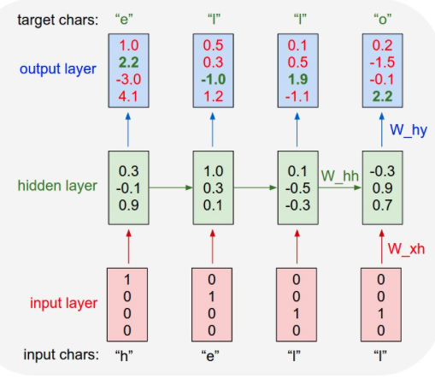
On the need of deep architectures
Learning representations for text
It also works in character level
Andrej Karpathy, 2015
Notes:
The Unreasonable Effectiveness of Recurrent Neural Networks: http://karpathy.github.io/2015/05/21/rnn-effectiveness/

Slide 25
On the need of deep architectures
Learning representations for text
It also works in character level: Paul Graham generator (one char at time!)
The surprised in investors weren't going to raise money. I'm not the company with the time there are all interesting quickly, don't have to get off the same programmers. There's a super-angel round fundraising, why do you can do. If you have a different physical investment are become in people who reduced in a startup with the way to argument the acquirer could see them just that you're also the founders will part of users' affords that and an alternation to the idea. [2] Don't work at first member to see the way kids will seem in advance of a bad successful startup. And if you have to act the big company too."
Andrej Karpathy, 2015
Notes:
The Unreasonable Effectiveness of Recurrent Neural Networks: http://karpathy.github.io/2015/05/21/rnn-effectiveness/

Slide 26
Problems training deep architectures
Is this free lunch?
Note: Some of the following problems were addressed to some extent. In red we show possible ways to address the problems.
Feature design -> Neural networks architecture design (experience)
  How many neurons per layer, convolutions?, max-pooling?, recurrent?
Computational cost (gpus, ASIC)
  Several matrix multiplications and convolutions and they are not all embarrassingly parallel.
Curse of dimensionality (big data)
  The number of trainable weights sums up to millions

Slide 27
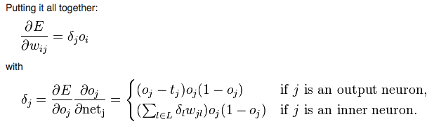
Problems training deep architectures
Is this free lunch?
Non-convex problem (problem?)
  Local minima problems seemed to be due to bad initialization and wrong activation function choices.
Vanishing gradients in backpropagation (improved SGD, LSTM)
Notes:
Qualitatively characterizing neural network optimization problems: http://arxiv.org/pdf/1412.6544v6.pdf (if we are in a local minima it is actually good enough)

Slide 28
Problems training deep architectures
Is this free lunch?
Need different learning rates for different layers (improved SGD)
  Output layer needs a stable representation to draw a separation surface (remember our example above)
Notes:
The Unreasonable Effectiveness of Recurrent Neural Networks: http://karpathy.github.io/2015/05/21/rnn-effectiveness/

Slide 29
Recent advances (or why now?)
Since deep learning is “just” neural networks, why is it happening only now?
Community acceptance (neural networks were labeled brute force and unreliable due to non-convex optimization, data descriptors + kernel machines were the prefered approach.)
  https://plus.google.com/+YannLeCunPhD/posts/gurGyczzsJ7
Faster computers with more memory
Larger datasets
Also, there were A LOT of incremental contributions
  To the beginner this may look like black magic, superstition or any other term for “not science”. But this is not true! Everything has a first principled foundation. Lets check it out!

Slide 30
Recent advances
Weight initialization techniques
Activation functions (relu, maxout, etc)
Regularization (dropout, batch normalization, multi-task learning)
Data agumentation
Optimization algorithms (momentum, adagrad, rmsprop, adam, etc)
Architectures (recurrent, convolutional, inception, residual, etc)
Deep learning software (CUDA, Caffe, Theano, Tensorflow, Keras, Torch, etc)
Deep learning hardware (CPU clusters, GPUs, ASIC, phones, etc)
Let us cover each topic individually!

Slide 31
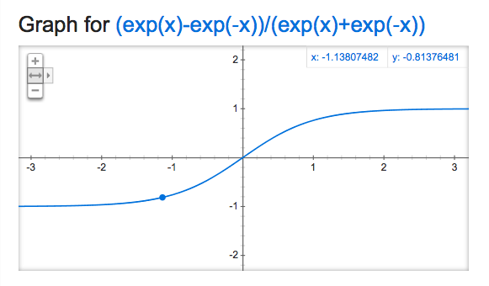
Recent advances
Weight initialization

Slide 32

Recent advances
Weight initialization
Too large: neurons get stuck into low gradient range
To small: neurons are too correlated which slows down learning
Glorot uniform initialization:
W_{ij} ~ U
Notes:
Understanding the difficulty of training deep feedforward neural networks - http://jmlr.org/proceedings/papers/v9/glorot10a/glorot10a.pdf

Slide 33
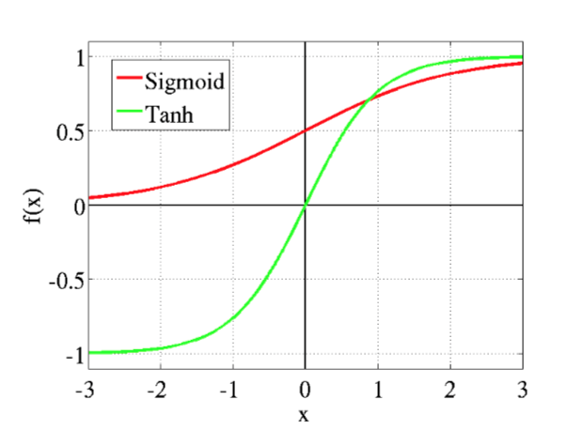
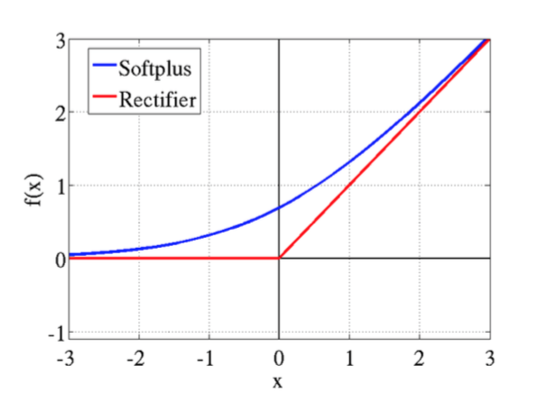
Recent advances
Activation functions
Softplus
ReLU
Notes:
Deep Sparse Rectifier Neural Networks - http://www.jmlr.org/proceedings/papers/v15/glorot11a/glorot11a.pdf

Slide 34
Recent advances
Activation functions
Softplus
ReLU
Approximate gradient doesn’t vanish for x>0.
Notes:
Deep Sparse Rectifier Neural Networks - http://www.jmlr.org/proceedings/papers/v15/glorot11a/glorot11a.pdf

Slide 35
Recent advances
Regularization (Dropout)
“If you’re not overfitting, your network isn’t big enough” - attributed to Geoff Hitton
How to design a Neural Network:
Before
  Start with a small network
  Increase number of neurons (and rarely number of layers) until you start overfitting
Now
  Start with a network big enough to overfit
  Increase regularization and data agumentation until you stop overfitting
  Increase network go back to step one until your hardware or other constraints are met.

Slide 36
Recent advances
Regularization (Dropout)
Dropout: randomly multiply by zero the outputs of the network during training. During test time rescale the learned weights down.
0.5
0
0
0.7
0.01
0.2
0.
1.
0.
1.
0.
1.
0.
0.
0.
0.7
0
0.2
*
=
Layer Output = f(w^{T}x)
Dropout mask with probability 0.5
New layer after masking
Notes:
Improving neural networks by preventing co-adaptation of feature detectors - http://arxiv.org/pdf/1207.0580v1.pdf

Slide 37
Recent advances
Regularization (Dropout)
Dropout: randomly multiply by zero the outputs of the network during training. During test time rescale the learned weights down.
0.5
0
0
0.7
0.01
0.2
0.
0.5
0.
0.5
0.
0.5
0.
0.
0.
0.35
0
0.1
Note that there can be different dropout proababilities! We just sample and rescale accordingly.
*
=
Layer Output = f(w^{T}x)
Dropout mask with probability 0.5 and rescale
New layer output after masking and rescale
Notes:
Improving neural networks by preventing co-adaptation of feature detectors - http://arxiv.org/pdf/1207.0580v1.pdf

Slide 38
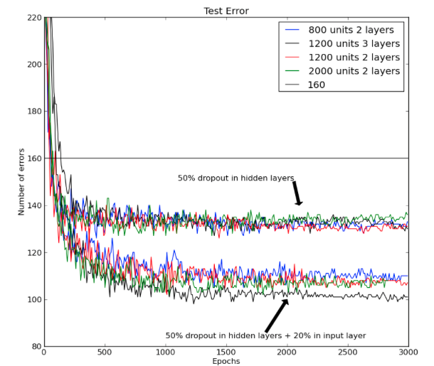
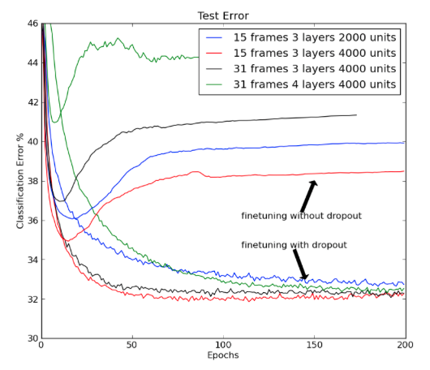
Recent advances
Regularization (Dropout)
Dropout prevents coadaptation of features. Intuition: during traning we add noise to the gradient so the weights don’t learn rely on each as much. We train them to work alone and bring friends during test time.
training
test
Hinton et. al. 2013
Notes:
Improving neural networks by preventing co-adaptation of feature detectors - http://arxiv.org/pdf/1207.0580v1.pdf

Slide 39
Recent advances
Regularization (Batch Normalization)
Let us remember the error surface for MSE and how correlated features impair learning.
J = E[(d - w^{T}x)²]= E[d²] + w^{T}Cw - 2w^{T}P
Where C is the autocorrelation matrix and P is the cross correlation matrix. This formula is quadradic with accelation matrix being a function of C.
Let us focus on the quadratic term for the 2D case:
wTCw = (w₁C₁₁ + w₂C₂₁)w₁ + (w₁C₁₂ + w₂C₂₂)w₂ = w₁²C₁₁ + w₂²C₂₂ + w₁w₂C₂₁C₁₂

Slide 40
Recent advances
Regularization (Batch Normalization)
wTCw = (w₁C₁₁ + w₂C₂₁)w₁ + (w₁C₁₂ + w₂C₂₂)w₂ = w₁²C₁₁ + w₂²C₂₂ + w₁w₂C₂₁C₁₂
Let us visualize contour level plots.
Correlated inputs = “narrow valleys”: in the learning surface!
C₂₁C₁₂ = 0
No correlation on the input. We learn as fast in all directions. Same variance for x₁ and x₂.
C₂₁C₁₂ = 0
But x₂ has higher variance than x₁
C₂₁C₁₂ = positive
and But x₂ has higher variance than x₁

Slide 41
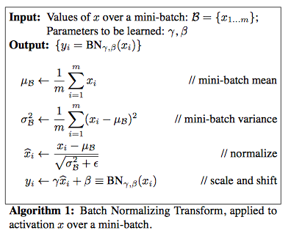
Recent advances
Regularization (Batch Normalization)
Also “eigenvalue spread” defines maximum learning rate, misadjustment, covergence time, etc.
Learning and correlated inputs are not friends! Batch normalization learns to “remove the mean and divide by std after every layer”
There is a version for conv layers too! In both cases, we learn a moving average approximation of the mean and variance that we use at test time (It is not fair to calculate test batche statistics in your experiments. Don’t do that in your homeworks or publications)
Notes:
Batch Normalization: Accelerating Deep Network Training by Reducing Internal Covariate Shift : http://arxiv.org/pdf/1502.03167v3.pdf

Slide 42
Recent advances
Data agumentation (noise)
For deep learning the more data the better! We already saw one way to increase the virutal size of our dataset: adding noise!
Dropout in the input
Adding Gaussian noise (works better for speech data)
Notes:
Batch Normalization: Accelerating Deep Network Training by Reducing Internal Covariate Shift : http://arxiv.org/pdf/1502.03167v3.pdf

Slide 43
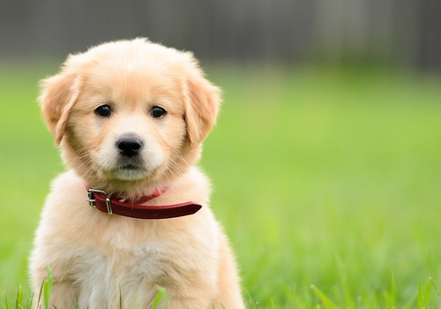
Recent advances
Data agumentation (data distortion)
There are also small transformation in the input that help neural networks to generalize better:
Vertical axis flip
Multipe crops (changes scale and position)
Rotation, changes viewing angles.
And they all can be combined for even more augmentation.
Notes:
For advanced augmentation techniques see Fractional max-pooling: http://arxiv.org/pdf/1412.6071v4.pdf

