Slide 1
Neural Networks
University of Florida
Eder Santana

Slide 2
Topics
Radial Basis Functions
Convolutional Neural Networks

Slide 3
Topics
Radial Basis Functions
Convolutional Neural Networks

Slide 4
Radial basis functions - Topics
Inner products
RKHS
Cover’s Theorem

Slide 5
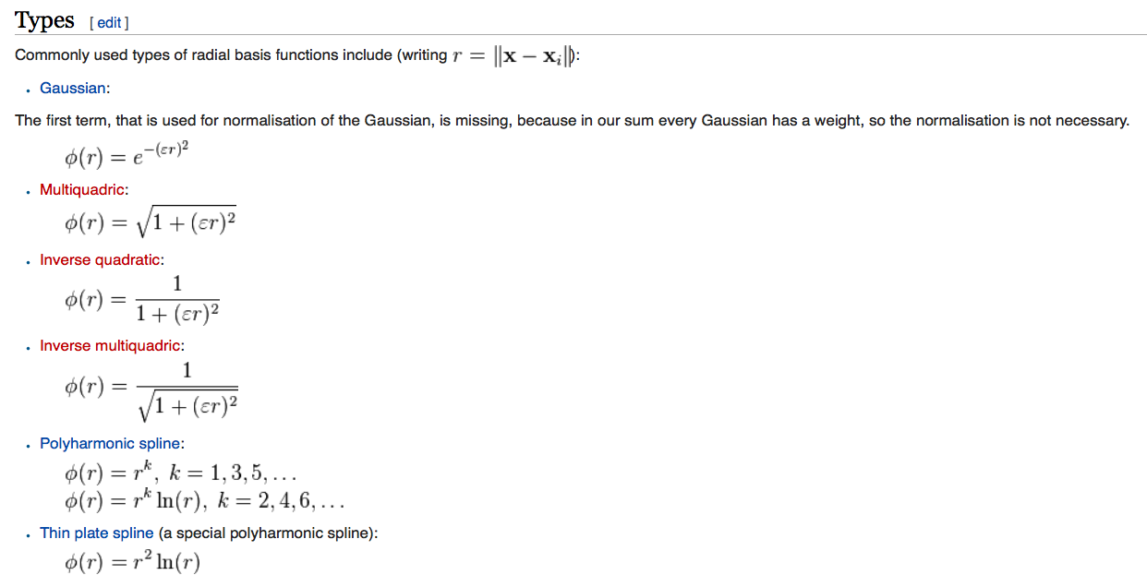
RBF
source: Wikipedia

Slide 6
Convolutional Neural Network
Review FIRs
2D convolutions
Max-pooling
Shift and scale invariance

Slide 7
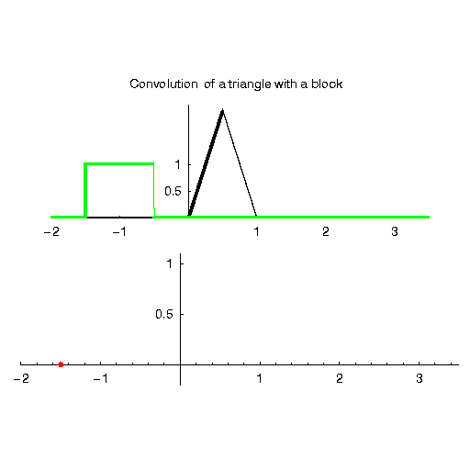
Convolutional Neural Network
Review FIRs
source: Wikipedia

Slide 8
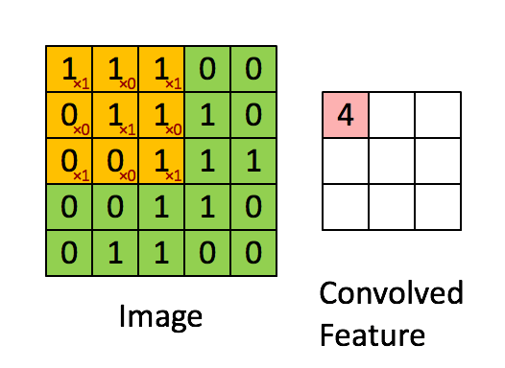
Convolutional Neural Network
2D Convolutions
source Stanford Tutorial: http://ufldl.stanford.edu/tutorial/supervised/FeatureExtractionUsingConvolution/

Slide 9
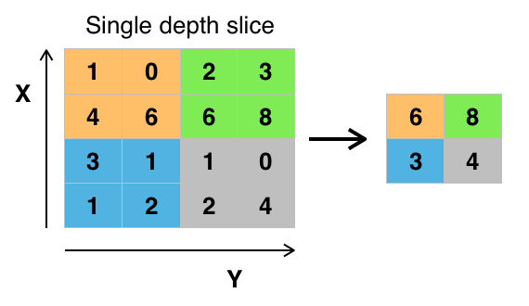
Convolutional Neural Network
Max-pooling
source: Wikipedia

Slide 10
Convolutional Neural Network
Shift and scale invariance:
https://www.youtube.com/watch?v=FwFduRA_L6Q
http://www.clarifai.com/#demo
source: Wikipedia

Slide 11
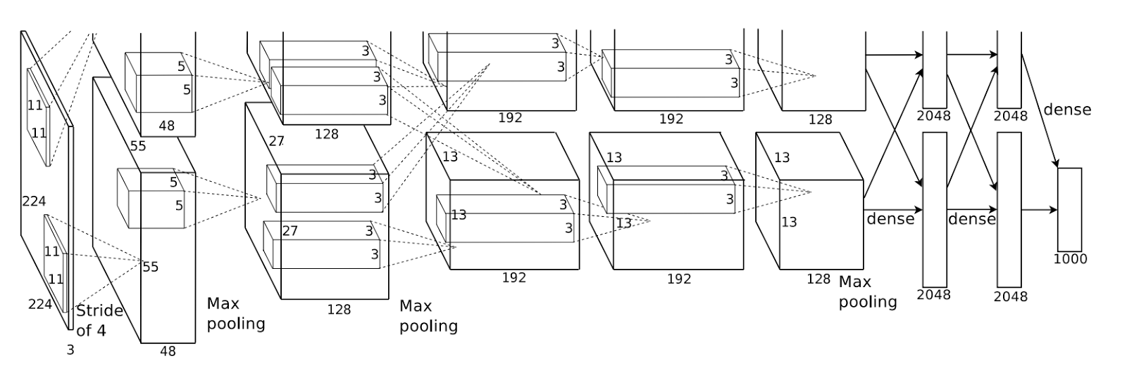
Convolutional Neural Network
Shift and scale invariance:
source: AlexNet

Slide 12
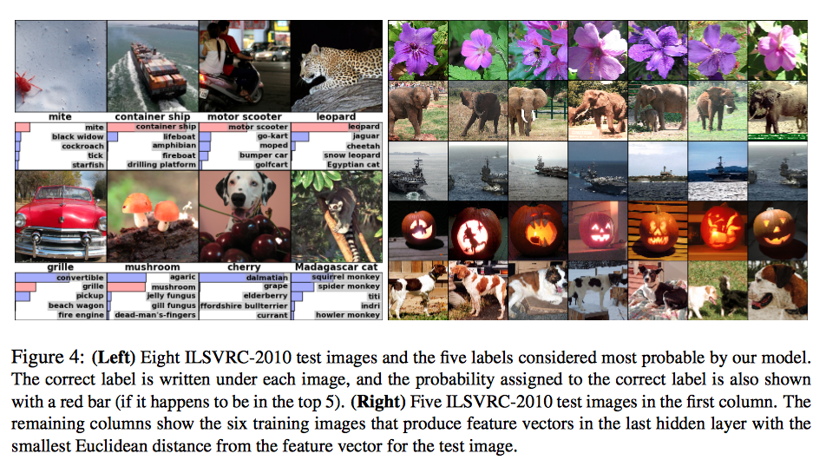
Convolutional Neural Network
source: AlexNet

Slide 13
Convolutional Neural Network
Shift and scale invariance:
Can you think of other symmetries that might be useful for machine learning?
source: AlexNet

