Slide 1

Online Kernel Learning
Jose C. Principe
Computational NeuroEngineering Laboratory (CNEL)
University of Florida
principe@cnel.ufl.edu

Slide 2
Acknowledgments
Dr. Weifeng Liu, Amazon
Dr. Badong Chen, Tsinghua University and Post Doc CNEL
NSF ECS – 0300340, 0601271, 0964197
(Neuroengineering program)

Slide 3
Outline
  Introduction
  Least-mean-square algorithm in Kernel Space
  Active Learning in Kernel Filtering
  Conclusion

Slide 4
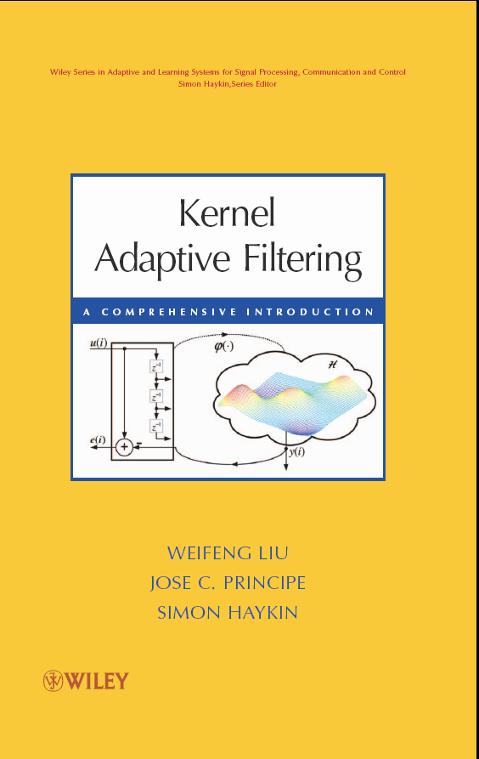
Wiley Book (2010)
Papers are available at
www.cnel.ufl.edu

Slide 5
Problem Setting
Machine Learning/Optimal Signal Processing seek to find optimal models for regression and time series.
  Linearity, Gaussianity, Stationarity, the fundamental assumptions for mathematical optimality are rarely realistic!
Only the linear model is well understood and widely applied!
  Neural Networks are a practical way of going beyond the linear model, but they have still many shortcomings.
Information Theoretic Learning goes beyond Gaussianity!
  Instead of second order moments uses the statistical data structure
Stationarity is a killer!
  Short windows, i.e. the model must be continuously adapting to track changes.
  Best Strategy: On-line learning methods that discover incrementally the mapping.
  Watch out: Optimal algorithms must obey physical constrains, FLOPS, memory, response time, battery power.

Slide 6
Optimal Modeling Fundamentals
Adaptive Filter Framework
  Filtering is regression in functional spaces (time series)
  Filter order defines the size of the subspace
Optimal solution is least squares w*=R⁻¹p , but now R is the autocorrelation of the data input (over the lags), and p is the crosscorrelation vector.
Data d(n)
Data u(n)
Adaptive
System
Output
Error e(n)
Cost
J=E[e²(n)]

Slide 7
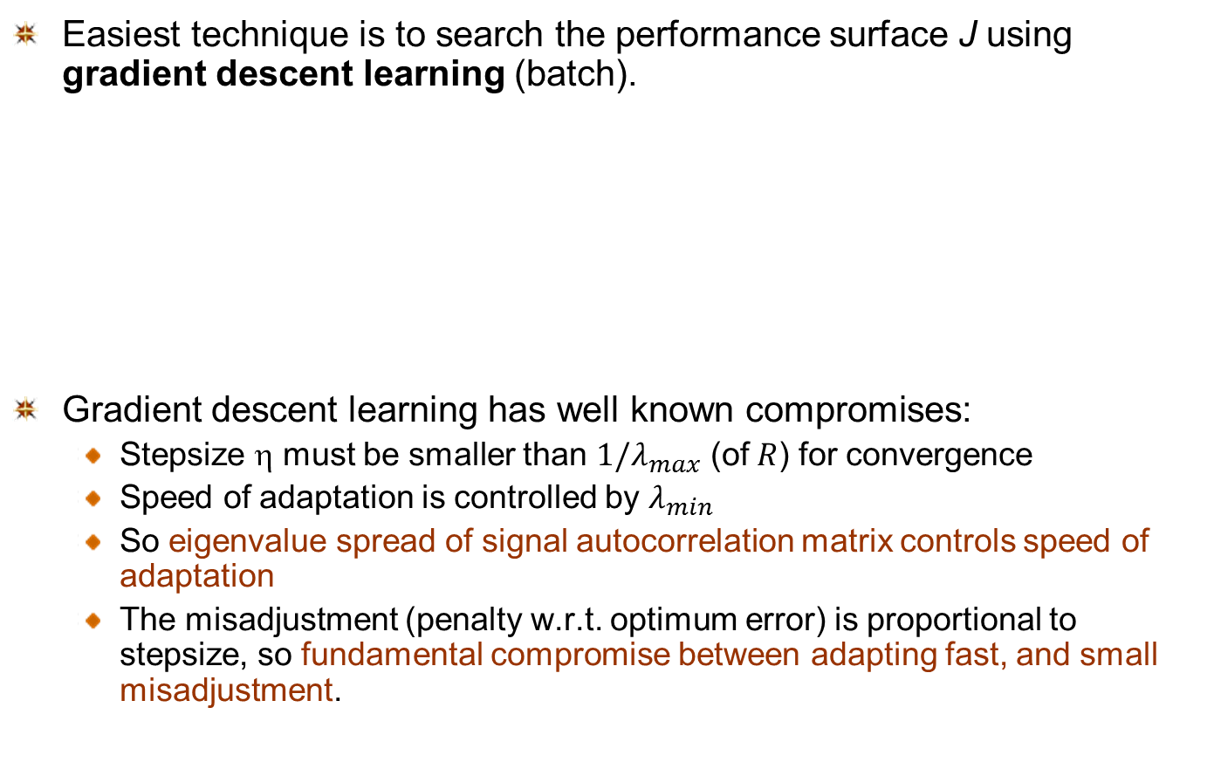
On-Line Learning for Linear Filters
Easiest technique is to search the performance surface J using gradient descent learning (batch).
Gradient descent learning has well known compromises:
  Stepsize η must be smaller than $1/λ_{max}$ (of $R$) for convergence
  Speed of adaptation is controlled by $λ_{min}$
  So eigenvalue spread of signal autocorrelation matrix controls speed of adaptation
  The misadjustment (penalty w.r.t. optimum error) is proportional to stepsize, so fundamental compromise between adapting fast, and small misadjustment.

Slide 8
On-Line Learning for Non-Linear Filters?
Can we generalize to nonlinear models?
and create incrementally the nonlinear mapping?

Slide 9
Non-Linear Models – Traditional
Volterra models
  too many parameters
Hammerstein and Wiener models
  An explicit nonlinearity followed (preceded) by a linear filter
  Nonlinearity is problem dependent
  Do not possess universal approximation property
Multi-layer Perceptrons (MLPs) with back-propagation
  Non-convex optimization
  Local minima
Radial basis function (RBF) networks
  Non-convex optimization for adjustment of centers
Reservoir Computing methods
  Still difficult to optimize the reservoir

Slide 10
Non-linear Modeling with Kernels
Universal approximation property (kernel dependent)
Convex optimization (no local minima)
Still easy to compute (kernel trick)
But normally require regularization
Sequential (On-line) Learning with Kernels
(Platt 1991) Resource-allocating networks
  Heuristic
  No convergence and well-posedness analysis
(Frieb 1999) Kernel adaline
  Formulated in a batch mode
  well-posedness not guaranteed
(Kivinen 2004) Regularized kernel LMS
  with explicit regularization
  Solution is usually biased
(Engel 2004) Kernel Recursive Least-Squares
(Vaerenbergh 2006) Sliding-window kernel recursive least-squares
Liu, Principe 2008,2009, 2010.

Slide 11
Neural Networks versus Kernel Filters
 | ANNs | Kernel filters
Universal Approximators | YES | YES
Convex Optimization | NO | YES
Model Topology grows with data | NO | YES
Require Explicit Regularization | NO | YES/NO (KLMS)
Online Learning | YES | YES
Computational Complexity | LOW | MEDIUM
ANNs are semi-parametric, nonlinear approximators
Kernel filters are non-parametric, nonlinear approximators

Slide 12
Kernel Methods
Kernel filters operate in a very special Hilbert space of functions called a Reproducing Kernel Hilbert Space (RKHS).
A RKHS is an Hilbert space where all function evaluations are finite
Operating with functions seems complicated and it is! But it becomes much easier in RKHS if we restrict the computation to inner products.
Most linear algorithms can be expressed as inner products. Remember the FIR

Slide 13
Kernel methods
Moore-Aronszajn theorem
  Every symmetric positive definite function of two real variables has a unique Reproducing Kernel Hilbert Space (RKHS), e.g. Gaussian function . In this space
Mercer’s theorem
  Let K(x,y) be symmetric positive definite. The kernel can be expanded in the series
  Construct the transform as
  Inner product

Slide 14
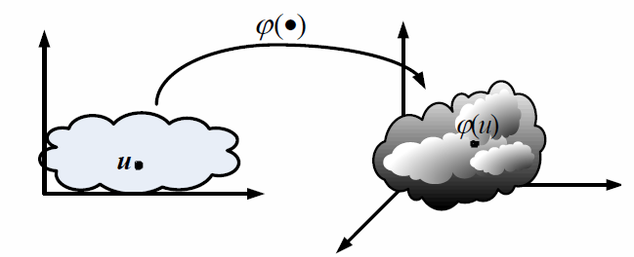
Kernel methods
Mate L., Hilbert Space Methods in Science and Engineering, A. Hildger, 1989
Berlinet A., and Thomas-Agnan C., “Reproducing kernel Hilbert Spaces in probaability and Statistics, Kluwer 2004

Slide 15
Basic idea of on-line kernel filtering
Transform data into a high dimensional feature space
Construct a linear model in the feature space F
Adapt iteratively parameters with gradient information
Compute the output
Universal approximation theorem
  For the Gaussian kernel and a sufficient large m_{i}, f_{i}(u) can approximate any continuous input-output mapping arbitrarily close in the L_{p} norm.

Slide 16
Growing network structure

Slide 17
Kernel Least-Mean-Square (KLMS)
Least-mean-square
Transform data into a high dimensional feature space F
RBF Centers are the samples, and Weights are the errors!

Slide 18
Kernel Least-Mean-Square (KLMS)

Slide 19
Free Parameters in KLMS
Initial Condition
The initialization gives the minimum possible norm solution.
Liu W., Pokarel P., Principe J., “The Kernel LMS Algorithm”, IEEE Trans. Signal Processing, Vol 56, # 2, 543 – 554, 2008.

Slide 20
Free Parameters in KLMS
Step size
Traditional wisdom in LMS still applies here.
where is the Gram matrix, and N its dimensionality.
For translation invariant kernels, κ(u(j),u(j))=g0, is a constant independent of the data.
The misadjustment is therefore

Slide 21
Free Parameters in KLMS
Rule of Thumb for h
Although KLMS is not kernel density estimation, these rules of thumb still provide a starting point.
Silverman’s rule can be applied
where σ is the input data s.d., R is the interquartile, N is the number of samples and L is the dimension.
Alternatively: take a look at the dynamic range of the data, assume it uniformly distributed and select h to put 10 samples in 3 σ.
Use cross validation for more accurate estimation

Slide 22
Free Parameters in KLMS
Kernel Design
The Kernel defines the inner product in RKHS
  Any positive definite function (Gaussian, polynomial, Laplacian, etc.) can be used.
  A strictly positive definite function will always yield universal mappers (Gaussian, Laplacian).
  For infinite number of samples all spd kernels converge in the mean to the same solution.
  But for finite number of samples kernel function and free parameters matter.
See Sriperumbudur et al, On the Relation Between Universality, Characteristic Kernels and RKHS Embedding of
Measures, AISTATS 2010

Slide 23
Sparsification
Filter size increases linearly with samples!
If RKHS is compact and the environment stationary, we see that there is no need to keep increasing the filter size.
Issue is that we would like to implement it on-line!
Two ways to cope with growth:
  Novelty Criterion (NC)
  Approximate Linear Dependency (ALD)
NC is very simple and intuitive to implement.

Slide 24
Sparsification
Novelty Criterion (NC)
Present dictionary is . When a new data pair arrives (u(i+1),d(i+1)).
First compute the distance to the present dictionary
If smaller than threshold δ1 do not create new center
Otherwise check if the prediction error is larger than δ2 to augment the dictionary.
δ1 ~ 0.1 kernel size and δ2 ~ sqrt of MSE

Slide 25
Sparsification
Approximate Linear Dependency (ALD)
Engel proposed to estimate the distance to the linear span of the centers, i.e. compute
Which can be estimated by
Only increase dictionary if dis larger than threshold
Complexity is O(m²)
Easy to estimate in KRLS (dis~r(i+1))
Can simplify the sum to the nearest center, and it defaults to NC

Slide 26
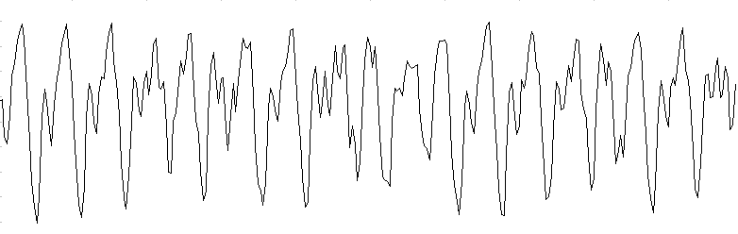
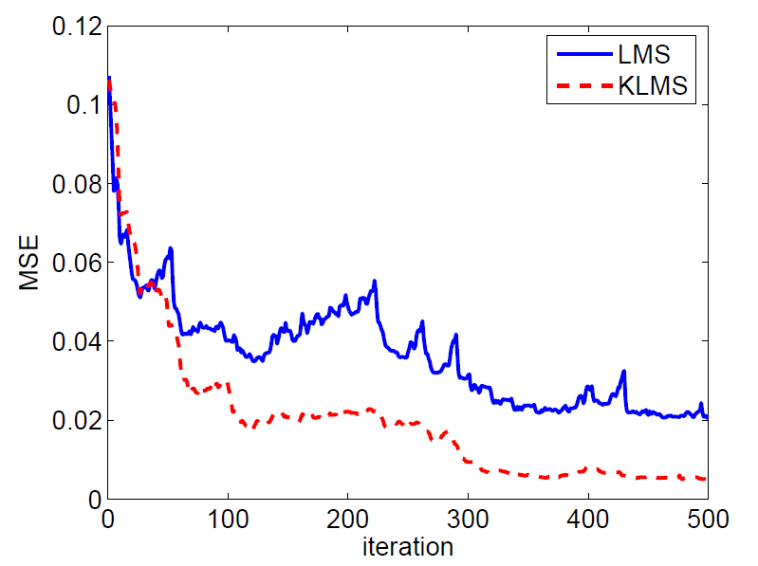
KLMS- Mackey-Glass Prediction
LMS
η=0.2
KLMS
h=1, η=0.2

Slide 27
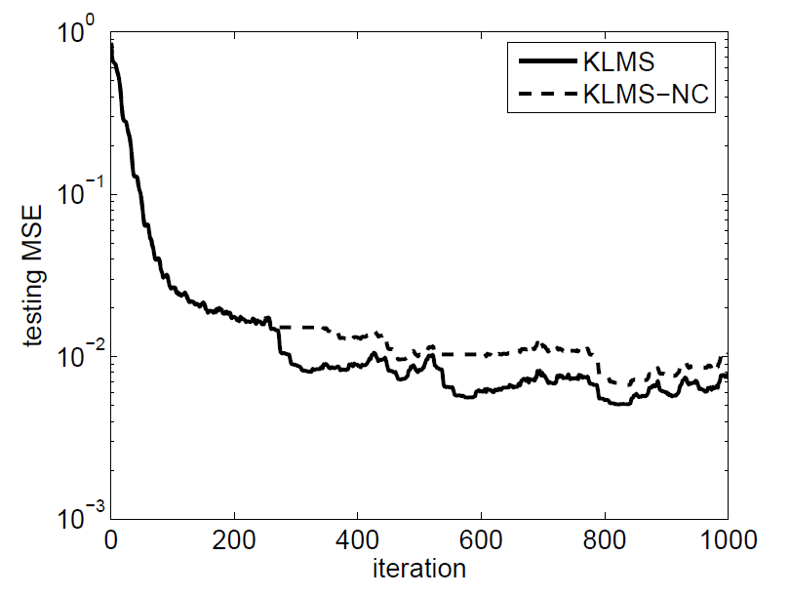
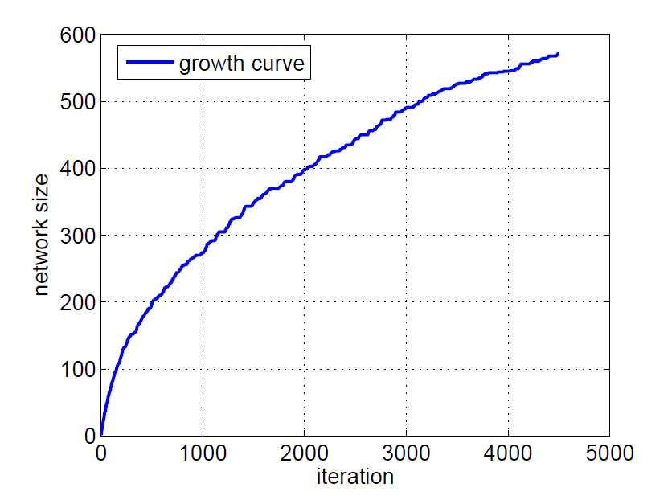
Performance Growth Trade-off
δ₁=0.1, δ₂=0.05
η=0.1, h=1

Slide 28
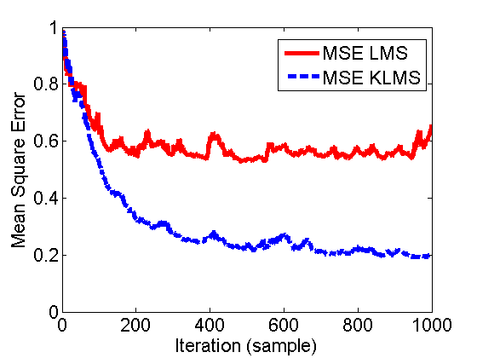
KLMS- Nonlinear Channel Equalization

Slide 29
Nonlinear Channel Equalization
Algorithms | Linear LMS (η=0.005) | KLMS (η=0.1) (NO REGULARIZATION) | RN (REGULARIZED λ=1)
BER (σ = .1) | 0.162±0.014 | 0.020±0.012 | 0.008±0.001
BER (σ = .4) | 0.177±0.012 | 0.058±0.008 | 0.046±0.003
BER (σ = .8) | 0.218±0.012 | 0.130±0.010 | 0.118±0.004
Algorithms | Linear LMS | KLMS | RN
Computation (training) | O(l) | O(i) | O(i³)
Memory (training) | O(l) | O(i) | O(i²)
Computation (test) | O(l) | O(i) | O(i)
Memory (test) | O(l) | O(i) | O(i)
Why don’t we need to explicitly regularize the KLMS?

Slide 30
Self-Regularization Property of KLMS
Assume the data model then for any unknown vector the following inequality holds
as long as the matrix is positive definite. So
  H∞ robustness
  And is upper bounded
The solution norm of KLMS is always upper bounded i.e. the algorithm is well posed in the sense of Hadamard.
σ₁ is the largest eigenvalue of Gφ
Liu W., Pokarel P., Principe J., “The Kernel LMS Algorithm”, IEEE Trans. Signal Processing, Vol 56, # 2, 543 – 554, 2008.

Slide 31
Intuition: KLMS and the Data Space
KLMS only finds solutions on the data subspace! It does not care about the null space!
KLMS search is insensitive to the 0-eigenvalue directions
So if , and
The 0-eigenvalue directions do not affect the MSE
Liu W., Pokarel P., Principe J., “The Kernel LMS Algorithm”, IEEE Trans. Signal Processing, Vol 56, # 2, 543 – 554, 2008.

Slide 32
Energy Conservation Relation
The fundamental energy conservation relation holds in RKHS!
Energy conservation in RKHS
Upper bound on step size for mean square convergence
Steady-state mean square performance
Chen B., Zhao S., Zhu P., Principe J. Mean Square Convergence Analysis of the Kernel Least Mean Square Algorithm Signal Processing, 2012

Slide 33
Effects of Kernel Size
Kernel size affects the convergence speed! (A suitable kernel size should be selected by adaptation but it is still a hard problem)
However, it does not affect the final misadjustment! (universal approximation with infinite samples)

Slide 34
Affine Projection Algorithms (APA)
Let us write the LMS algorithm as
How can you interpret this?
So the LMS algorithm includes actually a single sample estimate of p(n) and R(n).
What if we use more than one sample to estimate these? We will improve estimation modestly instead of the RLS.
This is the essential idea of the Affine Projection Algorithms (APA)

Slide 35
Affine Projection Algorithms (APA)
Solve which yields
LMS uses a one sample approximation of
APA utilizes better (more samples) approximations
Therefore APA is a family of online gradient based algorithms of intermediate complexity between the LMS and RLS.
Several ways to approximate this solution iteratively use
  Gradient Descent Method (above)
  Newton’s iteration
  With regularized cost functions too

Slide 36
Kernel Affine Projection Algorithms (KAPA)
Solve which yields
where
If we use Newton’s update
For the regularized cost function we will obtain

Slide 37
The Big Picture for Gradient Based Learning
Kivinen
2004
Frieb , 1999
Engel, 2004
Affine Projection Algorithm APA
All algorithms have kernelized versions
The EXT RLS is a restrictive state model
Liu W., Principe J., “Kernel Affine Projection Algorithms”, European J. of Signal Processing, ID 784292, 2008.

Slide 38
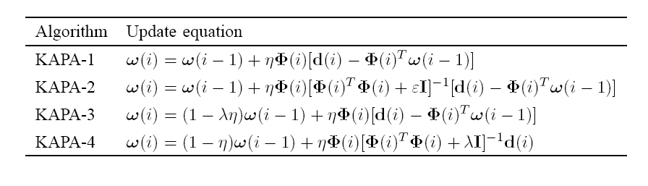
Kernel Affine Projection Algorithms
Q(i)
KAPA 1,2 use the least squares cost, while KAPA 3,4 are regularized
KAPA 1,3 use gradient descent and KAPA 2,4 use Newton update
Note that KAPA 4 does not require the calculation of the error by rewriting the error with the matrix inversion lemma and using the kernel trick
Note that one does not have access to the weights, so need recursion as in KLMS.
Care must be taken to minimize computations.

Slide 39
Recursive Least-Squares
The RLS algorithm estimates a weight vector w(i-1) by minimizing the cost function
The solution becomes
  And can be recursively computed as
Where . Start with zero weights and

Slide 40
Kernel Recursive Least-Squares (reg cost)
The KRLS algorithm estimates a weight function w(i) by minimizing
  The solution in RKHS becomes
  can be computed recursively as
  From this we can also recursively compute Q(i)
  And compose back a(i) recursively
with initial conditions

Slide 41
KRLS
Engel Y., Mannor S., Meir R. “The kernel recursive least square algorithm”, IEEE Trans. Signal
Processing, 52 (8), 2275-2285, 2004.

Slide 42
KRLS

Slide 43
Computation complexity
Prediction of Mackey-Glass
L=10
K=10
K=50 SW KRLS

Slide 44
Active Data Selection
Is the Kernel trick a “free lunch”? NO
  The price we pay is a growing memory to store centers
  Need to approximate this growing sum in practice
But remember we are working on an on-line scenario, so most of the methods out there need to be modified, since we have to find online criteria to discard samples.

Slide 45
Active Data Selection
The goal is to build a constant length dictionary (fixed budget) filter in RKHS. There are two complementary methods to achieve this goal:
  Discard unimportant centers (pruning)
  Accept only some of the new centers (sparsification)
Apart from heuristics, in either case a methodology to evaluate the importance of the centers for the overall nonlinear function approximation is needed.
Another requirement is that this evaluation should be no more expensive computationally than the filter adaptation.

Slide 46
Sparsification: Information Theoretic Statement
The learning system
  Already processed (the dictionary)
A new data pair arrives
How important is this new pair for learning?
  How much new information it contains?
  How much information it contains with respect to the learning system ?
The last question is what matters!

Slide 47
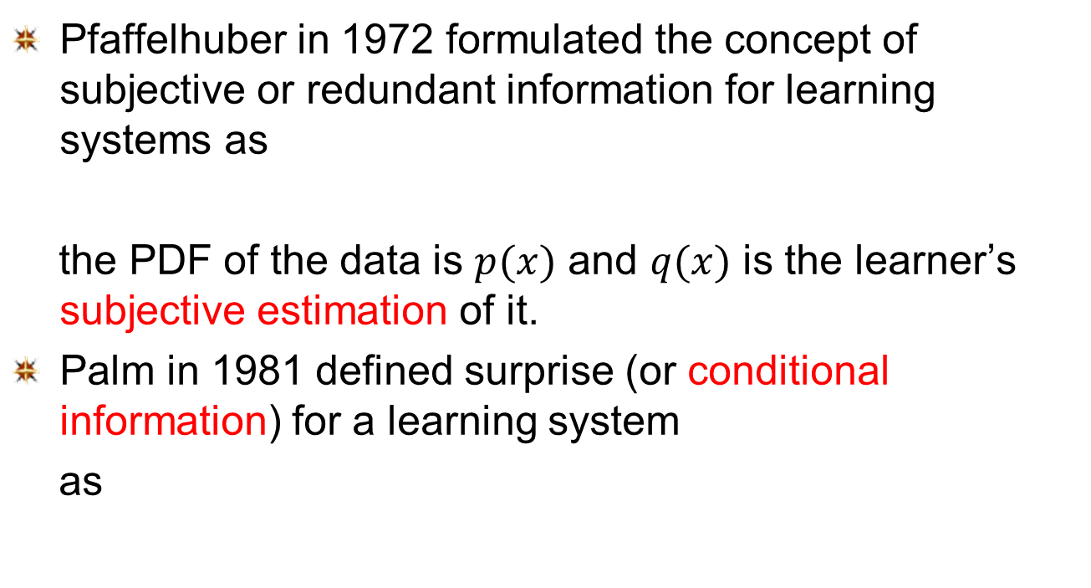
Surprise as an Information Measure
Pfaffelhuber in 1972 formulated the concept of subjective or redundant information for learning systems as
the PDF of the data is $p(x)$ and $q(x)$ is the learner’s subjective estimation of it.
Palm in 1981 defined surprise (or conditional information) for a learning system
as

Slide 48
Online Evaluation of Conditional Information (surprise)
Gaussian process theory
where
For KLMS we approximate the predictive variance as

Slide 49
Interpretation of Surprise
Prediction error
  Large error → large conditional information
Prediction variance
  Small error, large variance → large S
  Large error, small variance → large S (abnormal)
Input distribution
  Rare occurrence → large S

Slide 50
Redundant, abnormal and learnable
Still need to find a systematic way to select these thresholds which are hyperparameters.

Slide 51
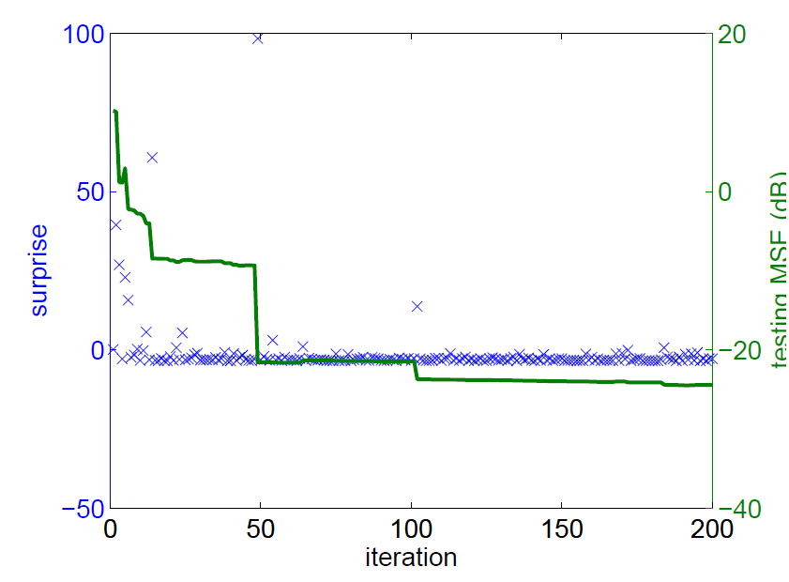
Simulation-5: KRLS-SC nonlinear regression
Nonlinear mapping is y=-x+2x²+sin x with additive unit variance Gaussian noise

Slide 52
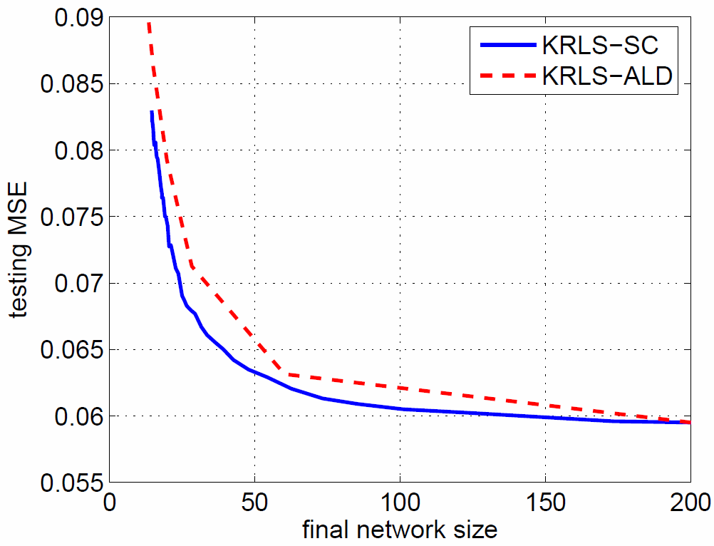
Simulation-5: nonlinear regression

Slide 53
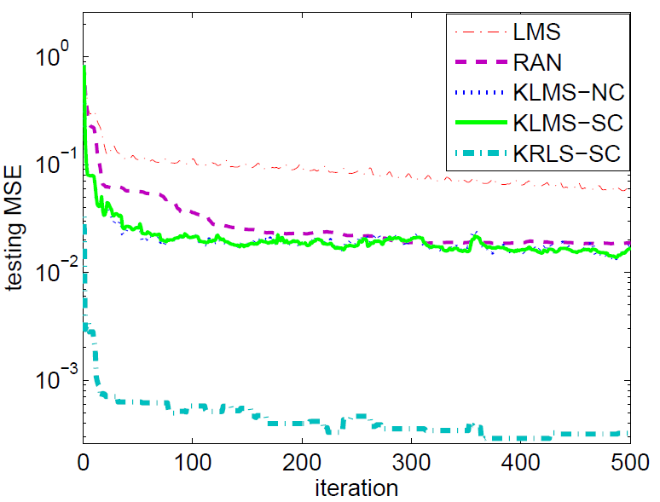
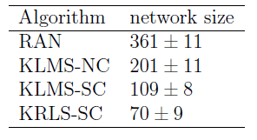
Simulation-7: Mackey-Glass time series prediction

Slide 54
Quantized Kernel Least Mean Square
The common drawback of sparsification methods: the redundant input data are purely discarded!
The redundant data are very useful to update the coefficients of the current network (not so important for structure updating).
Quantization approach: if the current quantized input has already been assigned a center, we don’t need to add a new center, but update the coefficient of that center with the new information!
Intuitively, the coefficient update may yield better accuracy and therefore a more compact network.
Chen B., Zhao S., Zhu P., Principe J. Quantized Kernel Least Mean Square Algorithm, submitted to IEEE Trans. Neural Networks

Slide 55
Quantized Kernel Least Mean Square
Quantization in Input Space
Quantization in RKHS
Using the quantization method to
compress the input (or feature) space
and hence to compact the RBF
structure of the kernel adaptive filter
Quantization operator

Slide 56
Quantized Kernel Least Mean Square
Most of the existing VQ algorithms are not suitable for online implementation because the codebook must be supplied in advance (which is usually achieved offline), and the computational burden is rather heavy.
A simple online VQ method:
Compute the distance between u(i) and C(i-1)
2. If keep the codebook unchanged, and quantize u(i) to the closest code-vector by
3. Otherwise, update the codebook: , and do not quantize u(i).
4. Just has a single free parameter (the neighborhood size)

Slide 57
Quantized Kernel Least Mean Square
Short Term Lorenz Time Series Prediction

Slide 58
Pruning Techniques
The goal is to create a fixed budget algorithm, hence samples need to be discarded from the dictionary, when a new sample is brought into the dictionary.
Therefore one has to evaluate the significance of discarding a sample k for the overall performance, which can be defined as
This needs to be done with the same complexity of KLMS and with a criterion that can be estimated online

Slide 59
Pruning Techniques
Utilized the idea of Huang (generalized growing and pruning RBFs)
Describe the significance statistically as
And adapt to an online scenario
Which gives the significance of one center c_{k} on the overall dictionary at time i. λ_{k}(i) is the influence of the center that quantifies how many centers merged and when.
G. Huang, P. Saratchandran, and N. Sundararajan, “A generalized growing and pruning rbf (ggap-rbf) neural network for function approximation,” IEEE Transactions on Neural Networks, vol. 16, no. 1, pp. 57–67, 2005.

Slide 60
Recursive Estimation of Significance
A new center is added and there is room to grow
If the input u(i) is merged in center c_{k}
If a center is pruned then
The integral is approximated as (Parzen estimation)
Update for significance
β is the forgetting factor close to 1.

Slide 61
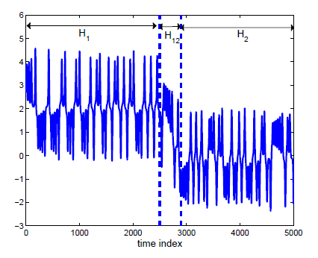
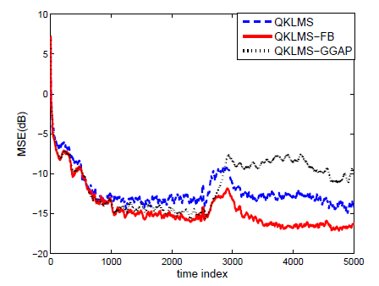
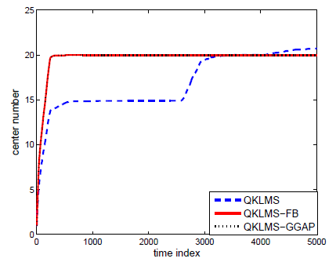
Example
Budget fixed at 20

Slide 62
Future Research
Find the best operating point to represent well the data (MSE) and dictionary length (rate distortion theory)
Adapt the kernel size during learning
Compare with other algorithms
Find a “killer” application

Slide 63
Generality of the Methods Presented
The methods presented are general tools for designing optimal universal mappings, and they can also be applied in statistical learning, not just in time series
Can we apply online kernel learning for Reinforcement learning? Definitely YES.
Can we apply online kernel learning algorithms for classification? Definitely YES.
Can we apply online kernel learning for more abstract objects, such as point processes or graphs? Definitely YES

